Slide 1
Renewable cities, Vancouver May 14th 2015
E MOBILITY IN COPENHAGEN?
Brian Hansen
Head of City Development Department
Notes:
Welcome to you all
I am going to talk about how Copenhagen is aiming to become carbon-neutral in 2025 and how mobility is going to help us get there

Slide 2
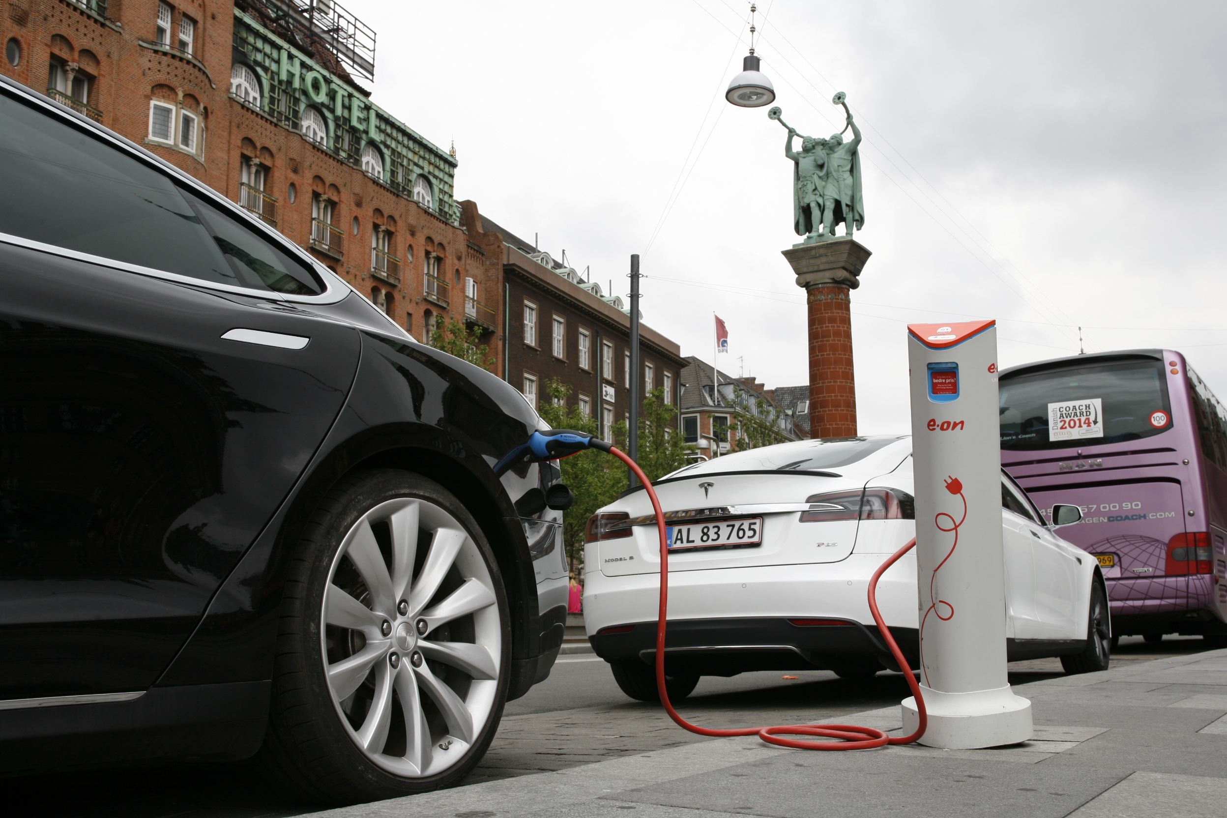

Slide 3
3,745
> 20,000 … a year!
Holland, 1/10
China 120 mio.
Germany ½ mio. (2012)

Slide 4
Infrastructure
Tax exemption
Parking fee exemption
Planning regulatives
Municipal procurement
…
0

Slide 8
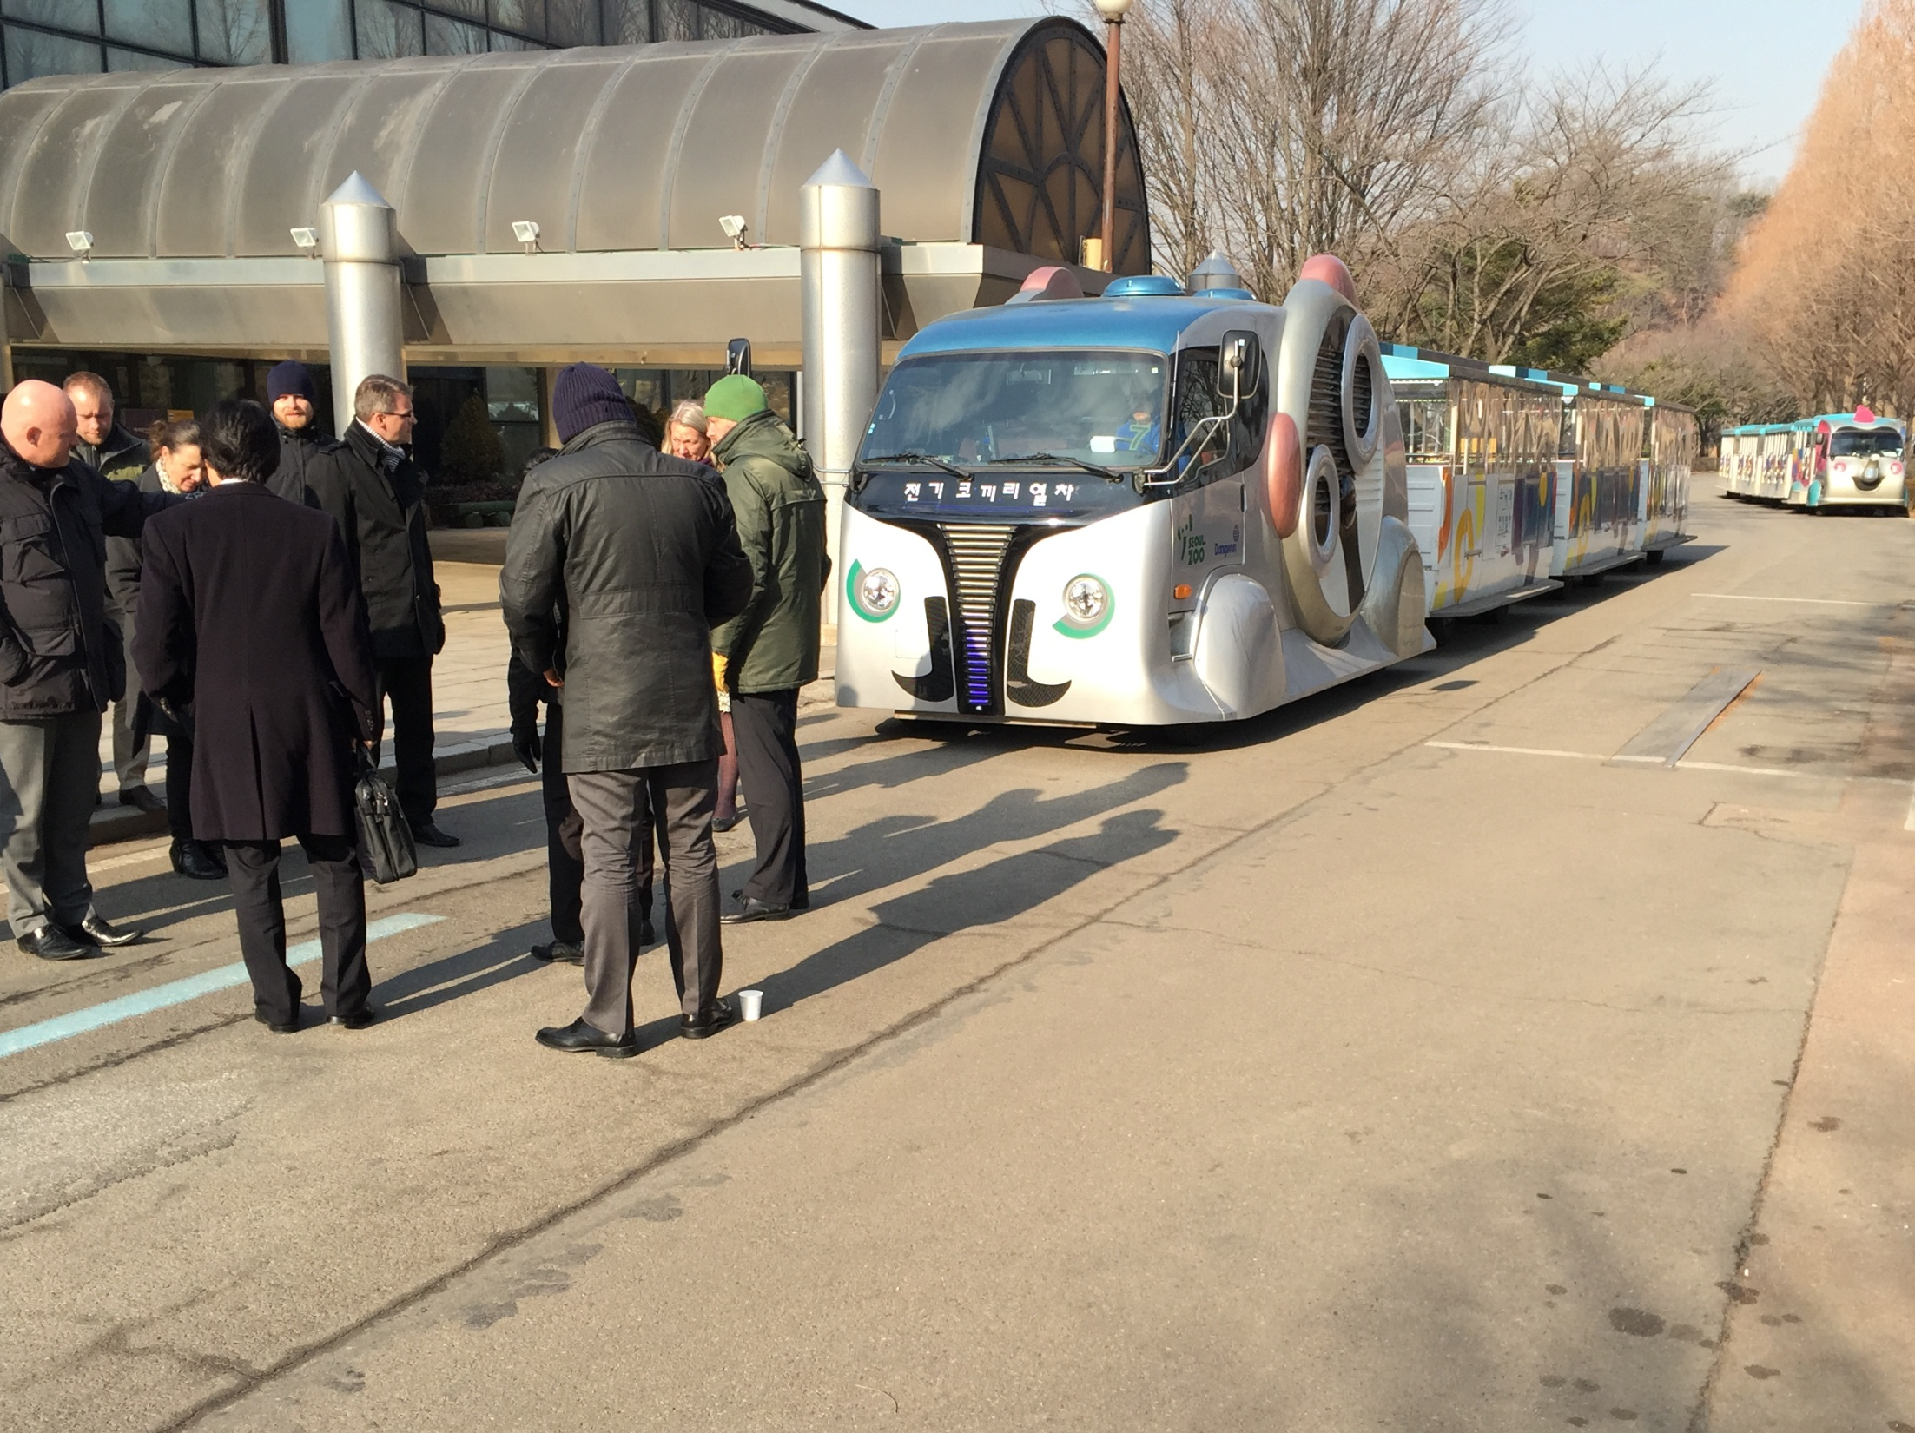
Public procurement:
Public transport
Municipal transport
Car sharing?

Slide 9
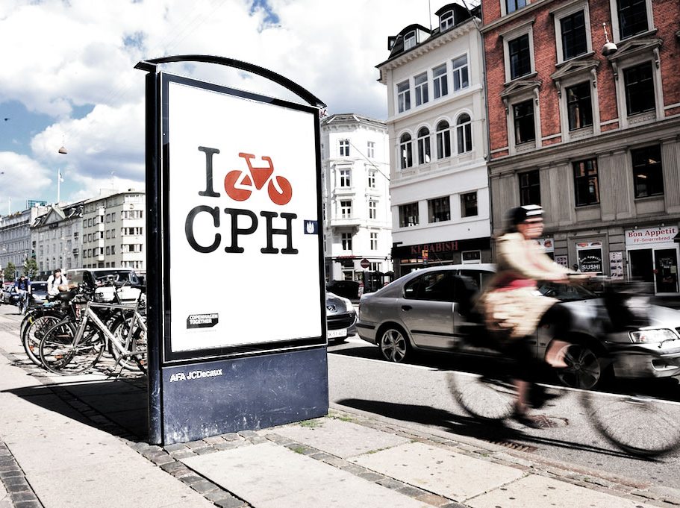
Brian.Hansen@tmf.kk.dk - www.kk.dk

