Slide 1
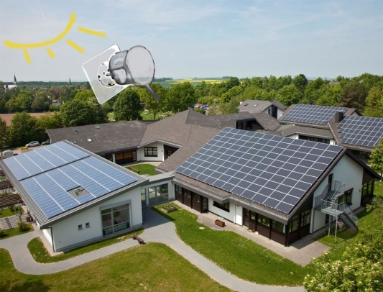
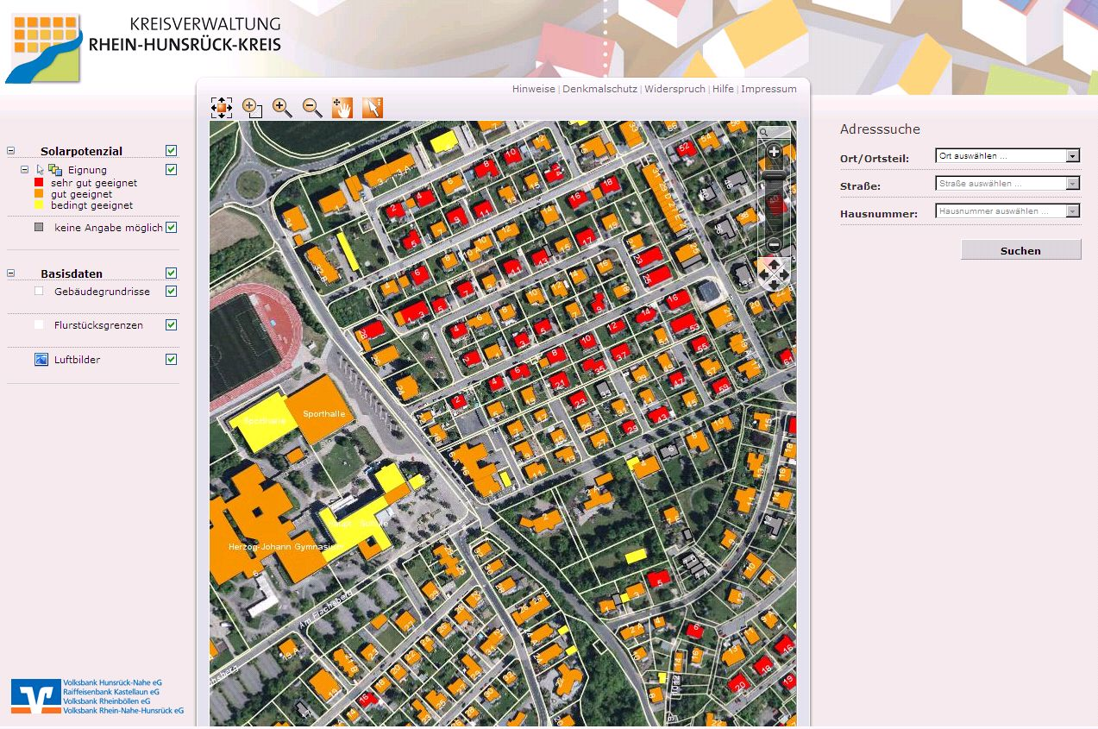
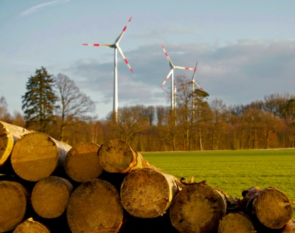
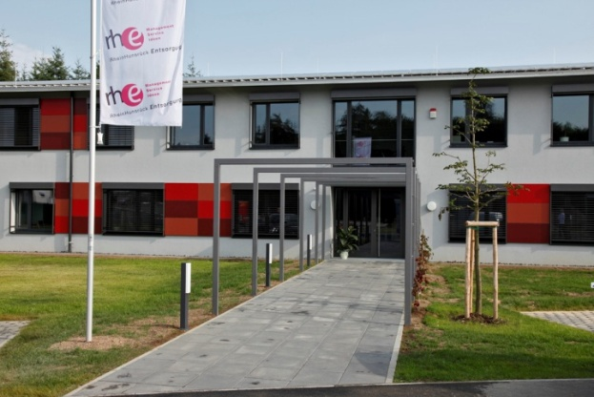
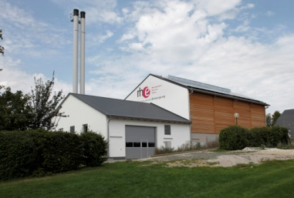
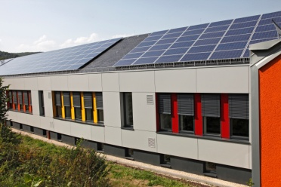
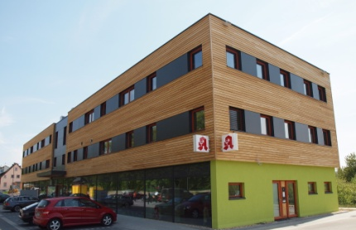
Rhein-Hunsrück District - from energy importer to energy exporter!
The part of the districts and local communities in the energy turnaround
Renewable Cities Conference, Head of the District o.d. – senior adviser - Mr. Bertram Fleck, May 2015, Vancouver

Slide 2
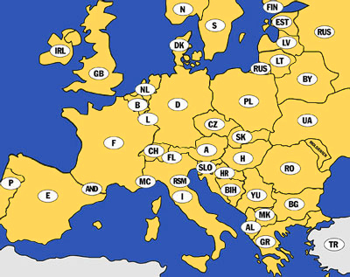
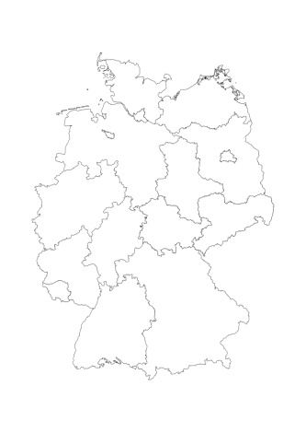
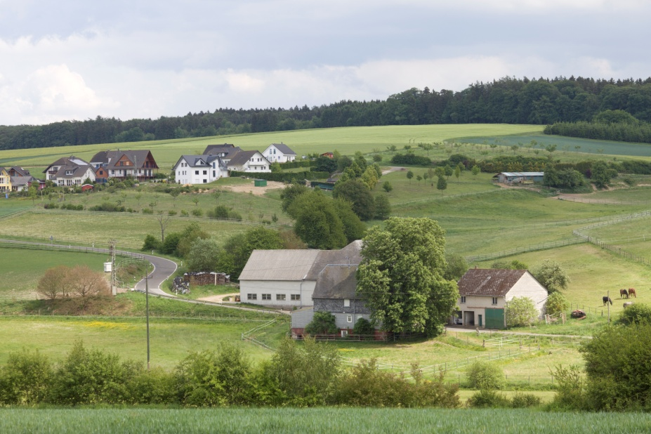
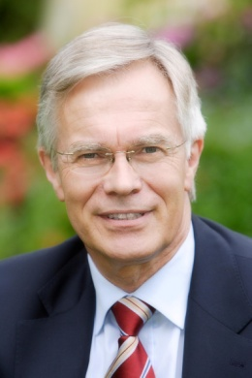
Introduction
Rhein-Hunsrück District
Germany
102.000 inhabitants
Area: 991 km²
137 settlements
(75% with less than 500 inhabitants)
Rhineland-Palatinate
Head of the District o.d. Rhein-Hunsrück senior adviser – Mr. Bertram Fleck
Hauptstraße 75a, 55481 Kirchberg / Germany
Tel: +49 151 44 682 999
Email: bertram.fleck@freenet.de
Renewable Cities Conference, Head of the District o.d. – senior adviser - Mr. Bertram Fleck, May 2015, Vancouver

Slide 3
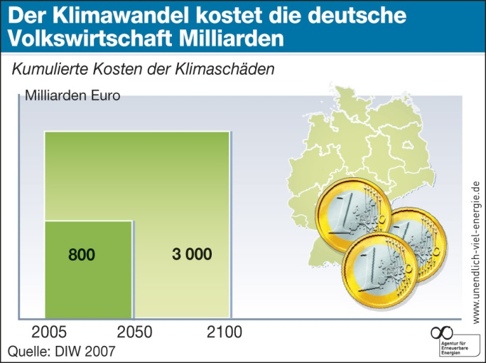
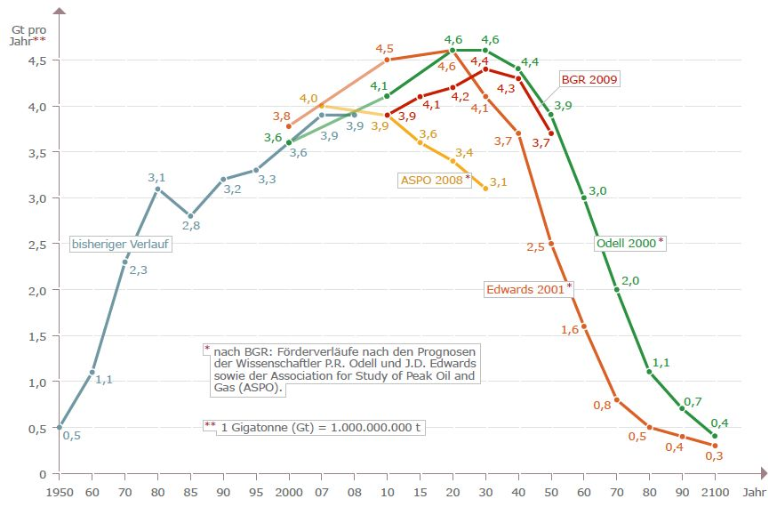
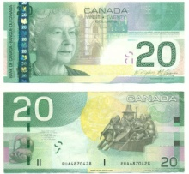
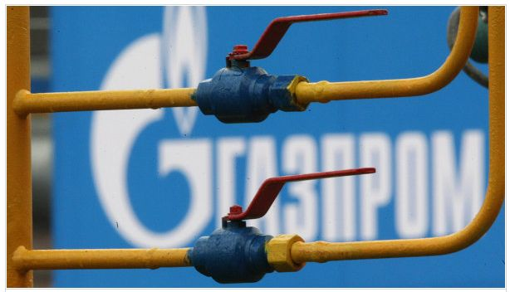
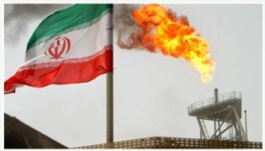
1. Keeping up the same old energy politics?
finite nature of fossil fuels
Climate change causes billions of costs for the German economics
Cumulative costs of climate-damages
Billions of CAD
effects of carbon dioxide on the climate
1.136
4.260
Source: German institut of economic research (DIW) 2007
dependence from energy-exporting-states
Explosive development of energy costs
Goals of the German Federal Government
 | Effici-ency | Share of renewables in electricity | CO₂
Goal of German Federal Government 2020: | 20 % | 35 % | 40 %
Goal of German Federal Government 2050: | 50 % | 80 % | 80 %
Renewable Cities Conference, Head of the District o.d. – senior adviser - Mr. Bertram Fleck, May 2015, Vancouver

Slide 4
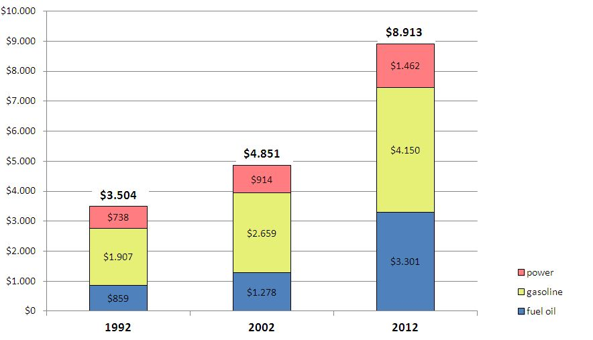
1. Keeping up the same old energy politics? Explosive development of fossil energy costs
average energy costs of an one-family household in CAD
consumption: 2.500 liter heating oil, 4.000 kWh electric power, 25.000 kilometers with car
total increase in 20 years: 5.409 CAD + 254 %
thereof apply 312 CAD for the renewable energy
assessment
in contrast: by raising efficiency and bulk
production renewable energy plants produce electricity and heat always more favorable (for example windpower on-shore at topical 12 Cent per kWh,
Photovoltaic on top 20 Cent pro kWh)
source: data 2002 and 2012: Verbraucherzentrale RLP , data 1992: own investigation
Renewable Cities Conference, Head of the District o.d. – senior adviser - Mr. Bertram Fleck, May 2015, Vancouver

Slide 5
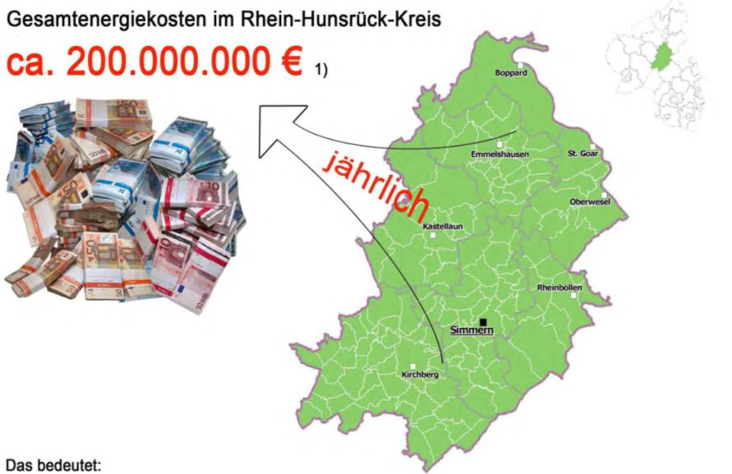
2. Goal: to transform 411 million CAD currently spent on energy imports into regional value added
Total expenditure on energy imports in Rhein-Hunsrück
approx. 411 Million CAD
Rhineland-Palatinate
annually
Total expenditure on energy imports in the Federal Republic of Germany in 2012: about 130 Billion CAD
40% more than in 2010
Goal of our Climate Protection Concept:
We aim at localizing the use of 355 Million CAD currently annually spent on energy imports!
Through improvements in energy efficiency and introduction of renewable energies we convert energy import costs into regional jobs and value added!
Renewable Cities Conference, Head of the District o.d. – senior adviser - Mr. Bertram Fleck, May 2015, Vancouver
Notes:
Key results of the Climate Protection Concept:
Cash outflows:
Electricity: approx. 113 million € / a
Heat: approx. 93 million € / a
Transport: approx. 87 million € / a
Total: approx. 293 million € / a
The climate protection concept enacted by the district council embrases measures based on the calculated local potentials. Through these measures, it is possible to localize approximately 250 million € annual energy procurement costs to be used the district till the year 2050.

Slide 6
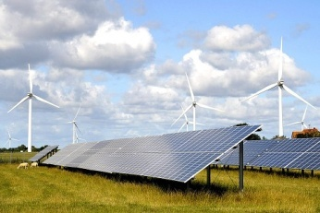
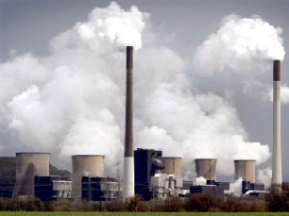
2. Goal: to transform 290 million € currently spent
on energy imports into regional value added
Percentage of Renewable Energies
2003
Optimization
Of Building- and
Redevelopment measures
2006
Resolution of a Energy Concept
for the District
2009
Energy Concept I
2010
Commission of IfaS
(College of technology)
Climate Protection Concept
1999
Energy controlling
District owned properties
2050
Reference Area for Sustainability
2020
Zero-Emission
(incl. Traffic a. Refuse)
2011
Submission of the Concept by IfaS
2012 - 2015
Realization of the Concept Part I - Manager for Climate Protection
- Expansion of Local Concepts
- Public Services through RE
- Civic Partizipation
time
Renewable Cities Conference, Head of the District o.d. – senior adviser - Mr. Bertram Fleck, May 2015, Vancouver

Slide 7
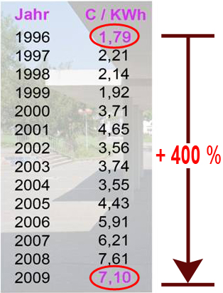
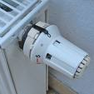
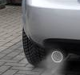
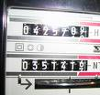
3. Example Energy Efficient Construction
Achievements of the energy controlling operating since 1999
Reduction of:
 Heat demand by 25 %
 Water demand by 26 %
CO₂ emissions 9.500 tons
Cost savings 2.840.000 CAD
During the same period, however,
heating energy costs have quadrupled!
Reduction of:
 Electricity demand 25 %
At the same time doubling number of PC‘s, introduction of air-conditioned server, introduction of catering and of all-day-schools. Only 5% increase effectively.
Without additional measures of energy controlling the increase would have amounted to 30%.
2005
Certified with the
Energy Seal of the State
of Rhineland-Palatinate
of District’s buildings by 2010
 Energy efficiency is the sleeping giant
Renewable Cities Conference, Head of the District o.d. – senior adviser - Mr. Bertram Fleck, May 2015, Vancouver

Slide 8
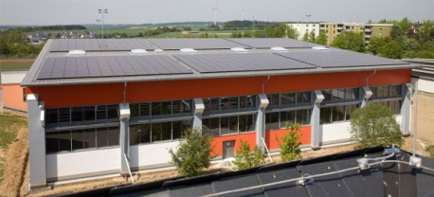
3. Example
Zero Emission Buildings
2010: The first Zero Emission School in the District
2006 : Connection to the local district heating grid (wood chips and plant oil CHP with native rapeseed)
2008: Conversion of swimming pool pump, Savings of electricity: 10,000 kWh per year
2007+2010: PV systems (electricity 93 kWp), Yield: 86.500 kWh / year
Surplus electricity: 33% for consumption
CO₂ credits: 14.5 t / year
2011: Sports Halls in
Simmern and Kirchberg
Zero emission sports halls
Renewable Cities Conference, Head of the District o.d. – senior adviser - Mr. Bertram Fleck, May 2015, Vancouver
Notes:
As the school was built in the mid 80s, nobody expected that the large roof area would optimally suit to produce energy 25 years later.
While extending the building from the year 2007 a photovoltaic plant with the capacity of 35 kWp was installed already during the construction period. Another photovoltaic plant with the capacity of 58 kWp was installed on the roof in May 2010 by the solar cooperative “Hunsrücksonne eG” from Kastellaun. Both plants produce altogether 86.500 kWh electricity per year. The school yearly consumes about 64.400 kWh electricity, there is a calculated surplus of 33% of electricity consumption. This shows the huge solar potential which is available on German roofs.
The special school for mental development has a therapy swimming pool. Energy controlling in 2008 has by the modification of a swimming pool pump, succeeded to reduce the annual electricity consumption by 10.000 kWh. Even only because of this the electricity balance is positive.
Since 2006 the heat supply is provided by a biomass power plant. This plant is operated with wood chips from the local forest. .
Due to the positive CO₂-balance the “Theodor-Heuss-school” is the first zero-emissions-school in the Rhein-Hünsrück district.

Slide 9
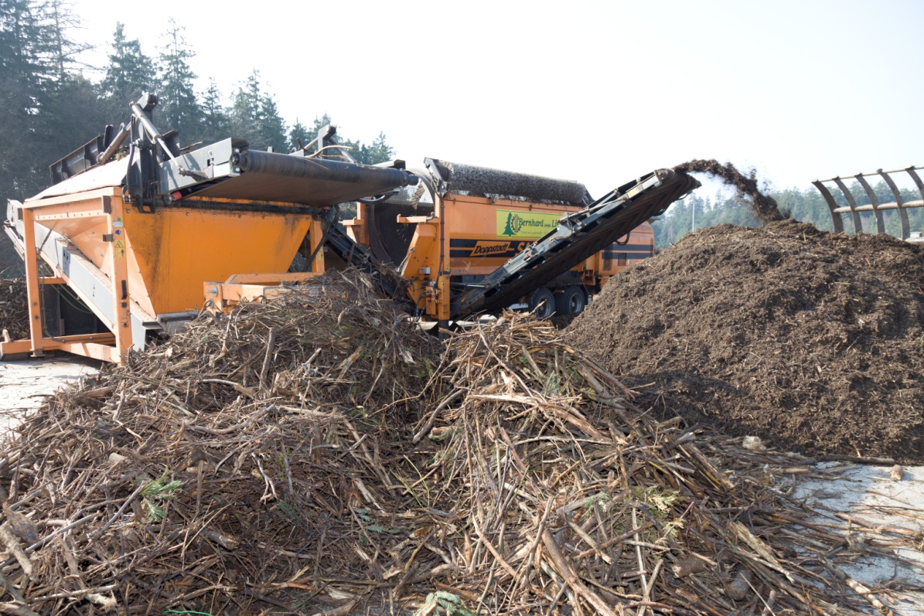
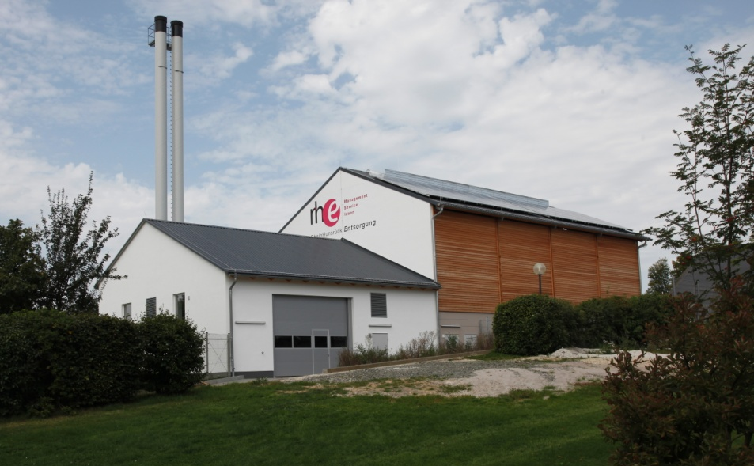
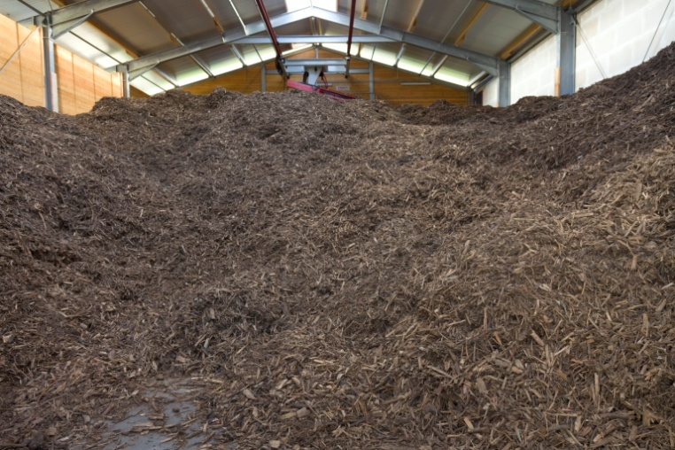
3. Example Material Flow Management: Bio-heating network
Public building complexes are merged to district heating networks and heated with tree and shrub cuttings (120 collecting points, central treatment place)
The first step: Fuel preparation in the central processing place
Startscreen
2009
Awarded Environmental
Prize of the State of
Rhineland-Palatinate
High quality compost:
approx. 50% of the total material
The second step:
Fuel:
approx. 50% of the total material
Thermal processing in the central heating station
with burning capacity of 500 to 850 kW
Central heating station
Fuel storage facility
Renewable Cities Conference, Head of the District o.d. – senior adviser - Mr. Bertram Fleck, May 2015, Vancouver

Slide 10
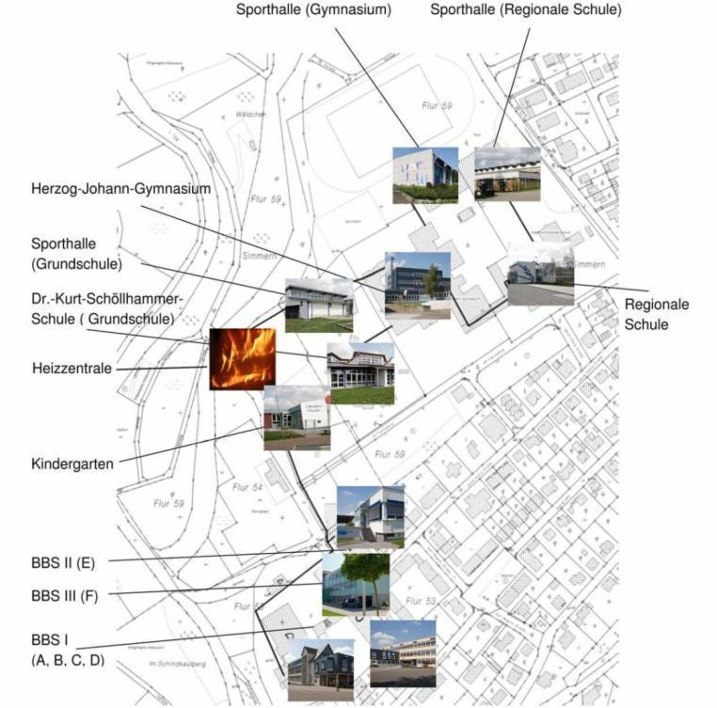
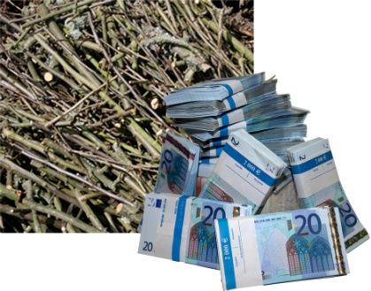
3. Example Material Flow Management: Bio-heating network
Public building complexes are merged to district heating networks and heated with tree and shrub cuttings (120 collecting points, central treatment place)
Central heating station
 Total investment 10 Million CAD clear
Three biomass-heating networks in schoolcenters:
22 school buildings,
8 sports halls, 1 town hall
2 indoor and 1 outdoor swimmingpools,
1 libary, 1 old people´s home
Annual savings
673.500 Liters
Fuel oil equivalent
 In the course of the next 20 years at least 15.6 Million CAD of energy delivery costs will stay within the region (by 6% increase of energy costs 30 Millionen CAD)
Renewable Cities Conference, Head of the District o.d. – senior adviser - Mr. Bertram Fleck, May 2015, Vancouver

Slide 11
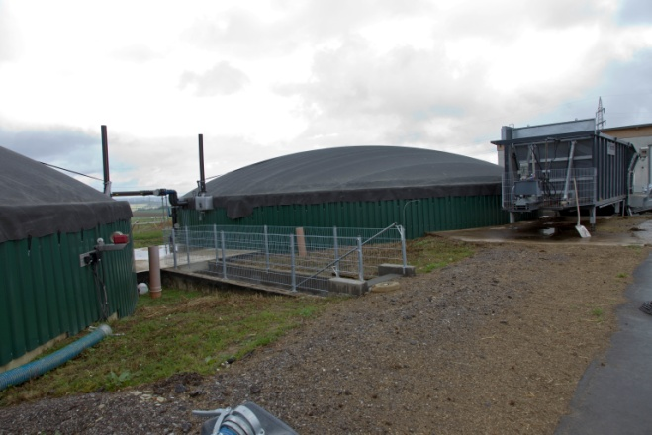
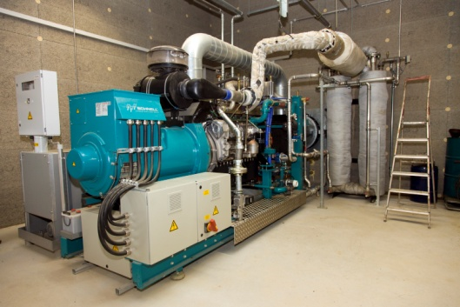
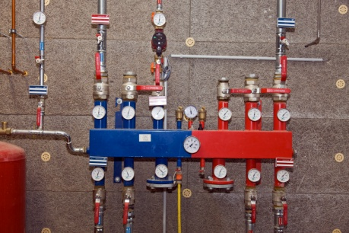
3. Development of Bio-energy Example: Biogas Plant on a Farm
Biogas plant on a farm including holiday flats (15 plants in district)
Area required: 110 ha Acreage
Power Output:
2 Million kWh per year
Thermal Output:
1,6 Million kWh per year
60 ha Maize Growing
Is completely injected into the Circuit
480.000 kWh Own Requirement of the Biogas Plant
30 ha Grassland
200 kW electr. power,
8.000 full load hours per year
300.000 kWh for the Heating of the House, Stable and Holiday Flats (Area of ca. 1.000 qm )
20 ha Ganzpflanzensilage
(Ackergras, Wintertriticale)
Baseloadable power generation
Residual heat cannot be used currently
Additional 30% Dung
45,3% forest area and 41,7% agriculture area in the district
11
Renewable Cities Conference, Head of the District o.d. – senior adviser - Mr. Bertram Fleck, May 2015, Vancouver

Slide 12
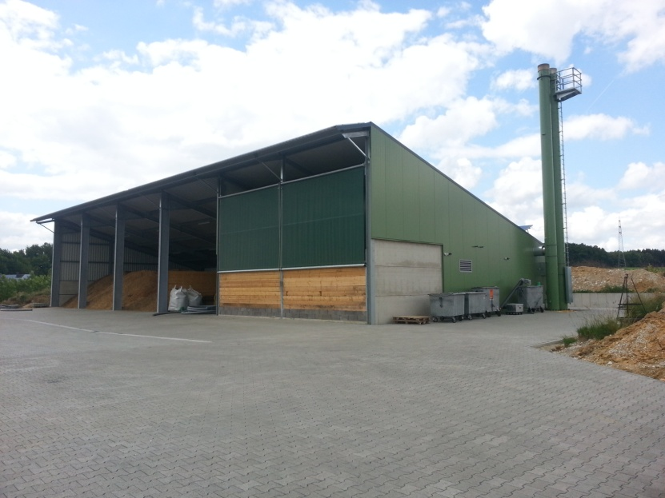
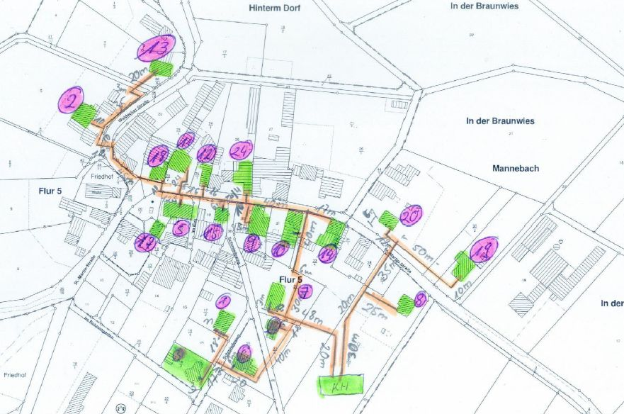
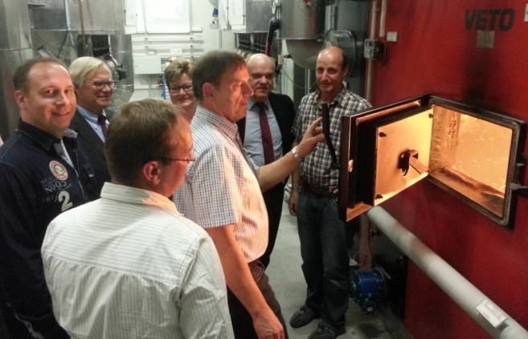
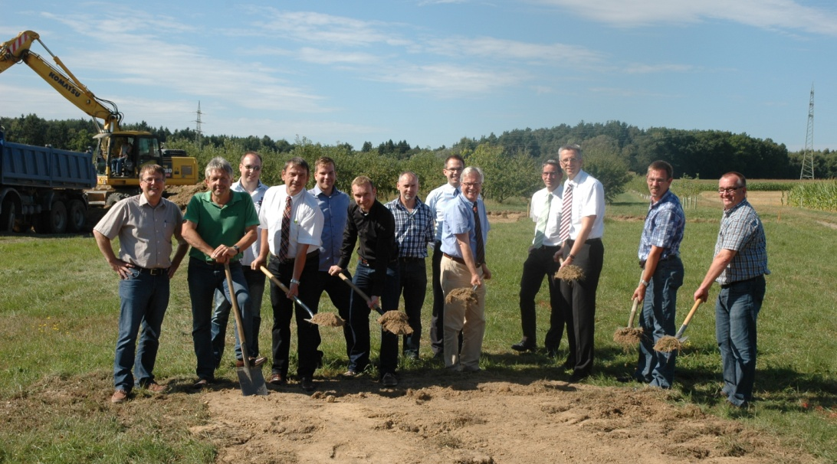
3. Example Local heat supply systems in communities
Community of Ober Kostenz 2013 256 inhabitants
72 houses from 91 houses
Wood chips, Operating since January 2014
„Energy Cooperative Ober Kostenz eG“
Status in May 2015:
10 biomass-heating networks in operation,
7 biomass-heating networks in development
source: Cooperative „Energy for Mannebach eG“
Renewable Cities Conference, Head of the District o.d. – senior adviser - Mr. Bertram Fleck, May 2015, Vancouver

Slide 13
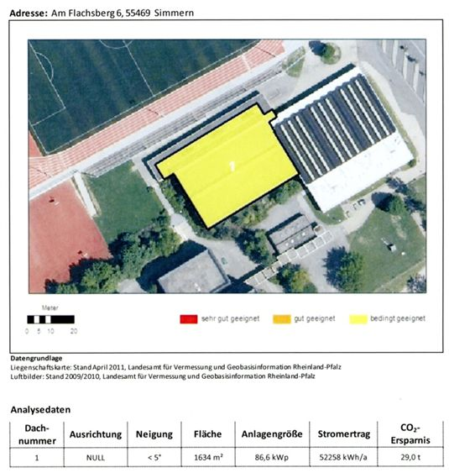
3. Example Roofs – Source of revenue
Target: 1000-Roofs-Photovoltaic-Program (Result: 3600 plants)
Rhein-Hunsrück District; Volksbank and Raiffeisen Bank Institutes in the District; Smart Geomatics; State agency for measuring
Only for owners specific information:
roof pitch
area
capacity
energy yield
Results:
Out of 80.000 roofs in the District 58.600 are suitable for PV.
Nearly the whole annual power demand of about 488 Mio. kWh could be covered.
At the moment already 13 % of this potential is used.
www.solarkataster-rhein-hunsrueck.de
Renewable Cities Conference, Head of the District o.d. – senior adviser - Mr. Bertram Fleck, May 2015, Vancouver

Slide 14
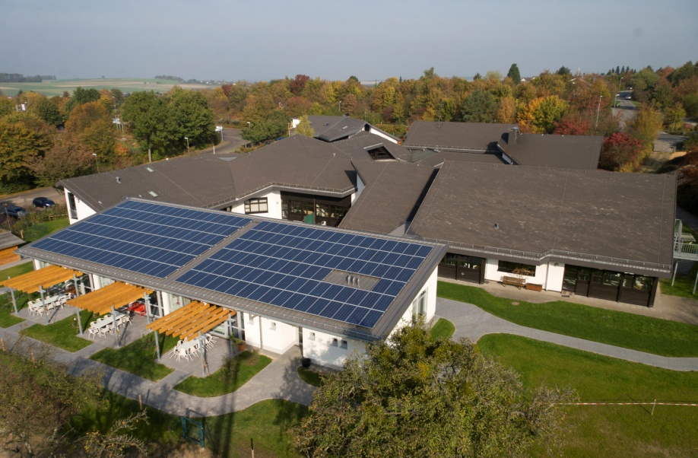
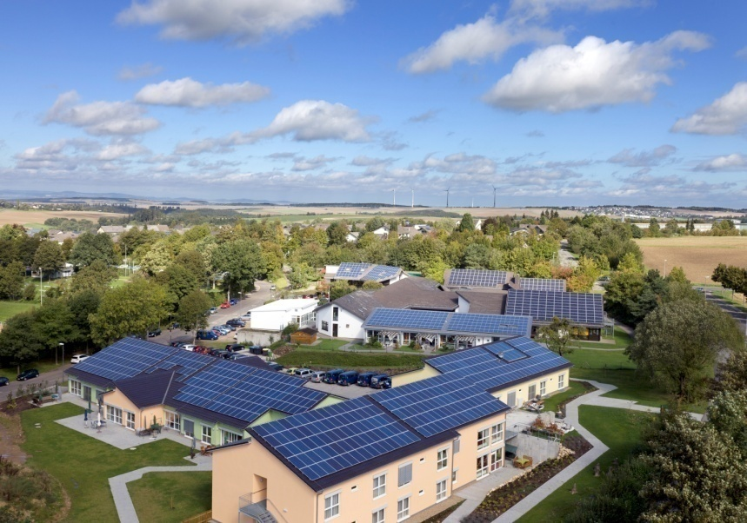
3. Example Usage of solar energy: District administration as a model
The District uses all suitable roofs
Example: School center
2007: 35 kWp
2011: 366 kWp
PV system in the school center:
The first school 35 kWp
The first school 93 kWp
The second school 153 kWp
Home for disabled 100 kWp
Kindergarten for disabled 20 kWp
Renewable Cities Conference, Head of the District o.d. – senior adviser - Mr. Bertram Fleck, May 2015, Vancouver

Slide 15
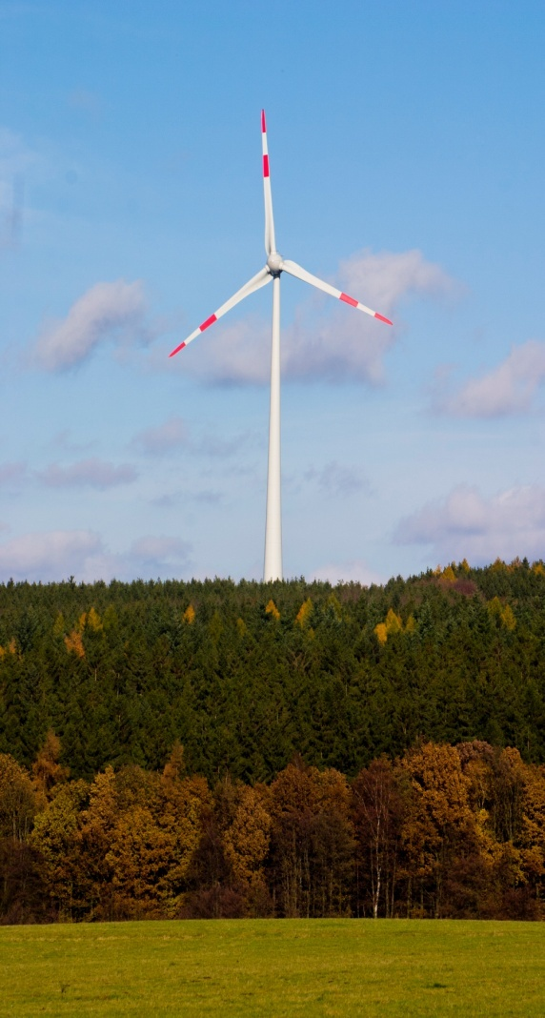
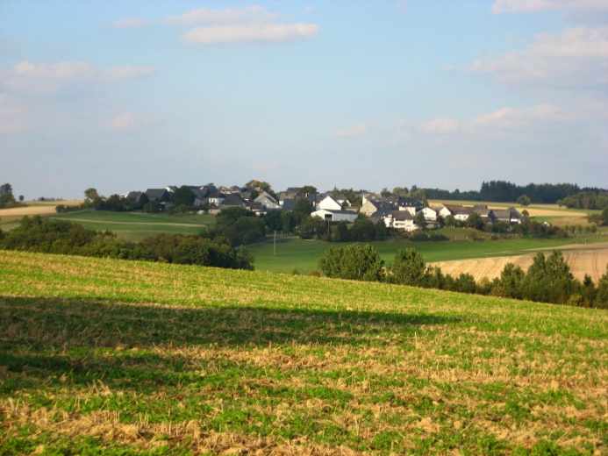
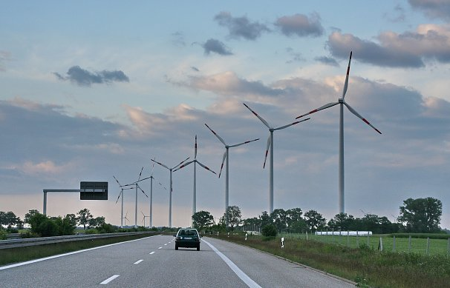
4. Promotion of acceptance of renewable energy
From today‘s 206 to 292 wind turbines – mostly on municipality areas - this changes the landscape
Acceptance through:
early and comprehensive public information
financial participation of the citizens
communal solidarity pact
cheaper electricity through direct marketing (citizen’s electricity, communal electricity)
Renewable Cities Conference, Head of the District o.d. – senior adviser - Mr. Bertram Fleck, May 2015, Vancouver

Slide 16
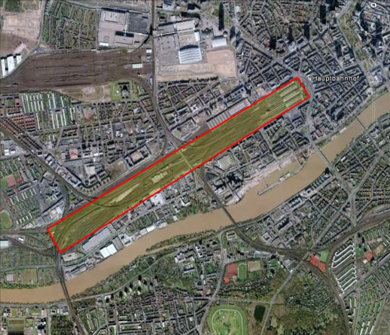
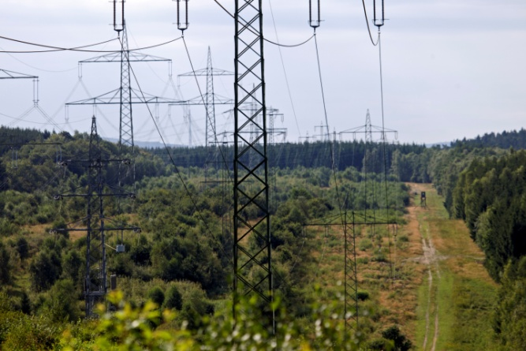
4. Energy gets visible –
promotion of acceptance of renewable energy
thesis : any generation modifies its landscape / familiarity is deciding
railway territory
for example Frankfurt central station :
72 ha
best area in the city center
marked area:
2.880 meter length
250 meter width
overhead line
in the district of Rhein-Hunsrück:
394 km overhead circuit
28 km maximum voltage (380 kV und 220 kV)
86 km high voltage (110 kV)
280 km middle voltage
road system
in the district of Rhein-Hunsrück:
993 km
42 km highways 158 km national highways
368 km state roads
425 km district roads
Renewable Cities Conference, Head of the District o.d. – senior adviser - Mr. Bertram Fleck, May 2015, Vancouver

Slide 17
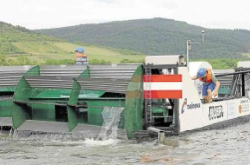
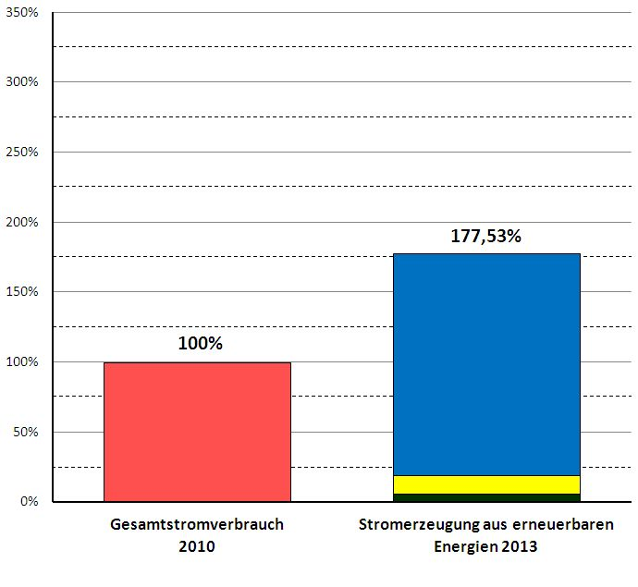
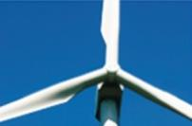
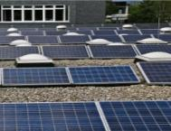
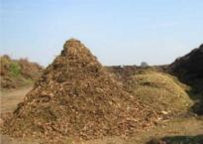
5. Share of electricity from renewable energy sources in the District in 2014 - already 177 %
Total electricity demand 488 Million kWh in 2010
Hydropower
Ø national 3,3 %
Pilot project in the River Rhine close to St. Goar (picture: Niederheimbach)
Wind energy
August 2013
158,69 %
Ø national 8,4%
34,33 %
nicht
regenerative
Energien
206 turbines 502 MW power
July 2014 in Operation
3.596 plants 73 MW power
Photovoltaics
13,19 %
Ø national 4,7 %
15 plants 4,4 MW power
Total energy consumption
2010
Eletricity generation out of
Renewable energies
2013
Biomass
5,65 %
Ø national 7,6 %
Percentage of Renewable Energies: 177 % Ø Whole of Germany 24 %
Renewable Cities Conference, Head of the District o.d. – senior adviser - Mr. Bertram Fleck, May 2015, Vancouver

Slide 18
5. Share of electricity from renewable energy sources in the District in 2014 - already 177 %
Total electricity demand 488 Million kWh in 2010
Hydropower
Ø national 3,3 %
Pilot project in the River Rhine close to St. Goar (picture: Niederheimbach)
Wind energy
August 2013
158,69 %
Ø national 8,4%
34,33 %
nicht
regenerative
Energien
2014
206 turbines 502 MW power
Approved & under consrtuction (50 plants )
July 2014 in Operation
3.596 plants 73 MW power
Photovoltaics
13,19 %
Ø national 4,7 %
15 plants 4,4 MW power
Total energy consumption
2010
Eletricity generation out of
Renewable energies
2013
Biomass
5,65 %
Ø national 7,6 %
Percentage of Renewable Energies: 226 % Ø Whole of Germany 24 %
Renewable Cities Conference, Head of the District o.d. – senior adviser - Mr. Bertram Fleck, May 2015, Vancouver

Slide 19
5. Share of electricity from renewable energy sources in the District in 2014 - already 177 %
Total electricity demand 488 Million kWh in 2010
Hydropower
Ø national 3,3 %
Pilot project in the River Rhine close to St. Goar (picture: Niederheimbach)
1,278 Billion kWh
Wind Energy
Applied for &
Approveable (38 Plants)
Wind energy
August 2013
158,69 %
Ø national 8,4%
2015
34,33 %
nicht
regenerative
Energien
Approved & under consrtuction (50 plants )
206 turbines 502 MW power
July 2014 in Operation
3.596 plants 73 MW power
Photovoltaics
13,19 %
Ø national 4,7 %
15 plants 4,4 MW power
Total energy consumption
2010
Eletricity generation out of
Renewable energies
2013
Biomass
5,65 %
Ø national 7,6 %
Percentage of Renewable Energies: 262 % Ø Whole of Germany 24 %
Renewable Cities Conference, Head of the District o.d. – senior adviser - Mr. Bertram Fleck, May 2015, Vancouver

Slide 20
6. Regional value added: conservative calculation of the District administration
Regional value added from renewable energies (business volume)
- lease income and taxes for the community
- feed-in-tarif for residents (partners in energy producing by PV and in cooperatives)
orders for workman and building contractor
maintenance by local business (job creation)
financial assistance by regional banks
development of local agriculture and forestry
development of tourist trade: hotels, restaurants
 |  |  |  | Regional value added
 |  | Total Investment of all renewable energy plants |  | Share of Regional Amount of Investment |  | Annual regional value added
 |  |  |  | (only one time)
Sum 2015 only with increase of wind power |  | ca. 1,85 billion CAD |  | ca. 144 million CAD |  | ca. 54 million CAD
Renewable Cities Conference, Head of the District o.d. – senior adviser - Mr. Bertram Fleck, May 2015, Vancouver

Slide 21
7. Climate protection concept: Zero Emission Rhein-Hunsrück District
Development of the Concept 2010-2011 by the Institute for applied Material Flow Management (IfaS)
opening balance sheet
potentials
9 workshops, 300 participants
closing balance sheet
The District will - on the balance sheet - become a zero emission District in electricity, heat and transport sectors already in 2020.
92 individual measures
climate protection manager
By using all potentials, annual energy delivery costs amounting to 355 million CAD can be saved in 2050.
Renewable Cities Conference, Head of the District o.d. – senior adviser - Mr. Bertram Fleck, May 2015, Vancouver

Slide 22
7. Climate protection concept: composition of an renovating-network
campaign : „Kastellaun renovates“ (220 houses in first accommodation) of a regional bank and a private company
betterment of the real property and essential increase of the dwelling value
The bisection of the energy demand and the renewable production of the permanent energy often is technically feasible and in a long term economical worthwhile !
Quelle: smart geomatics
Renewable Cities Conference, Head of the District o.d. – senior adviser - Mr. Bertram Fleck, May 2015, Vancouver

Slide 23
A lot of energy is hidden in Rhein-Hunsrück District - we are making use of it!
Friedrich Wilhelm Raiffeisen (1818–1888), founder of the worldwide-acting cooperative movement
It always seems impossible until it´s done !
Nelson Mandela
Renewable Cities Conference, Head of the District o.d. – senior adviser - Mr. Bertram Fleck, May 2015, Vancouver

