Slide 2
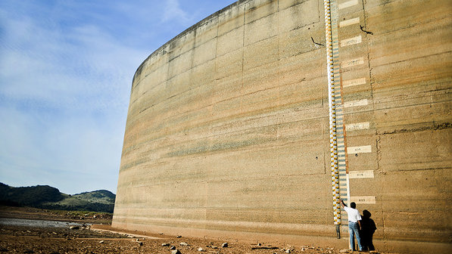
Brazilian electricity crisis
Causes and consequences
Severe drought;
Lack of diversification;
Tariff raise.
Brazilian electricity matrix

Slide 3
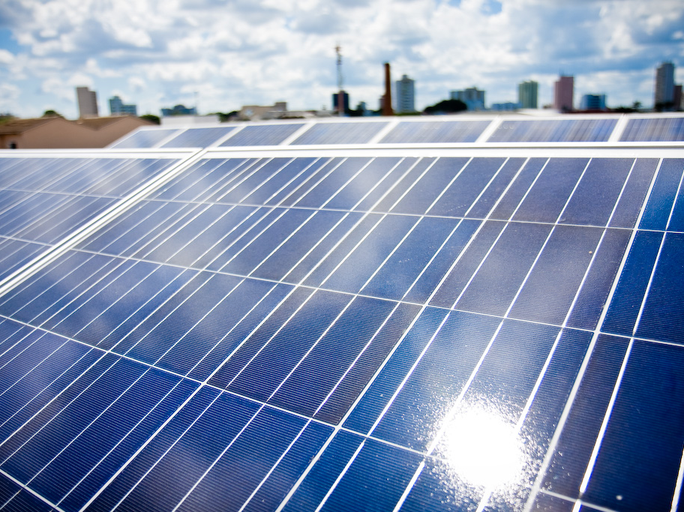
What about Solar Energy?
PV system: US$ 4.000
+ taxes: US$7.000
+ Lack of knowledge around the issue
+ Lack of financing options

Slide 4
EVERY CRISIS
IS AN
OPPORTUNITY
Notes:
Opportunity to point out the problems, connect them to the reality, propose solutions and demand public policies that will help solve the problem. In our case, the message we wanted to spread is that Solar energy is the solution our country needs, since it may help us solve many different issues. But first we need public power to invest on it.

Slide 5
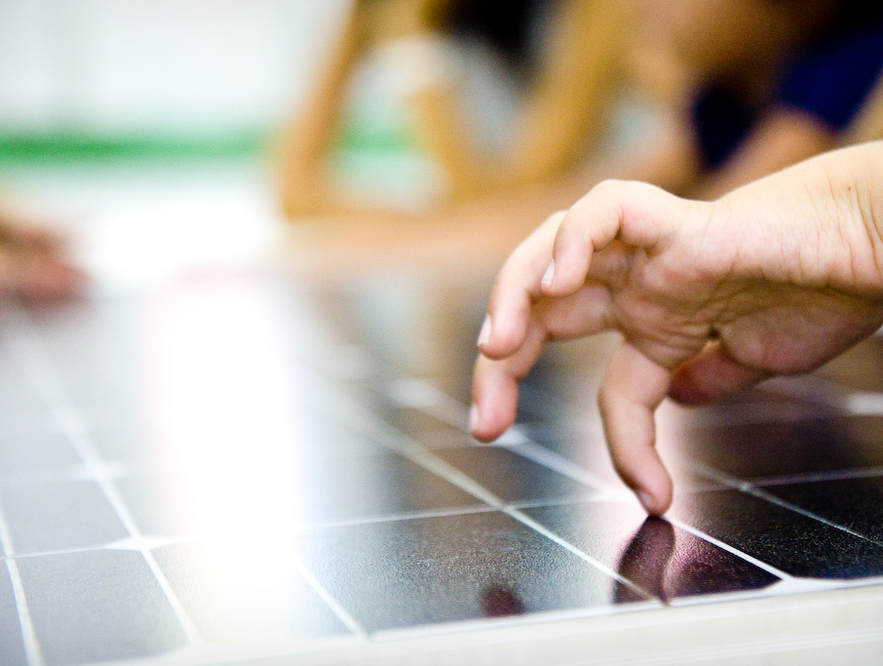
Showcase
the benefits of solar energy in order to:
create awareness;
get public support;
press public power.
Notes:
Among the many tactics available, we’ve decided that a showcase would be a good way to start addressing our message. Also, we’ve established some conditions for it, which are: Engagement; Awareness; Social benefits; People to feel touched or connected with it (in order to help us finance it).

Slide 6
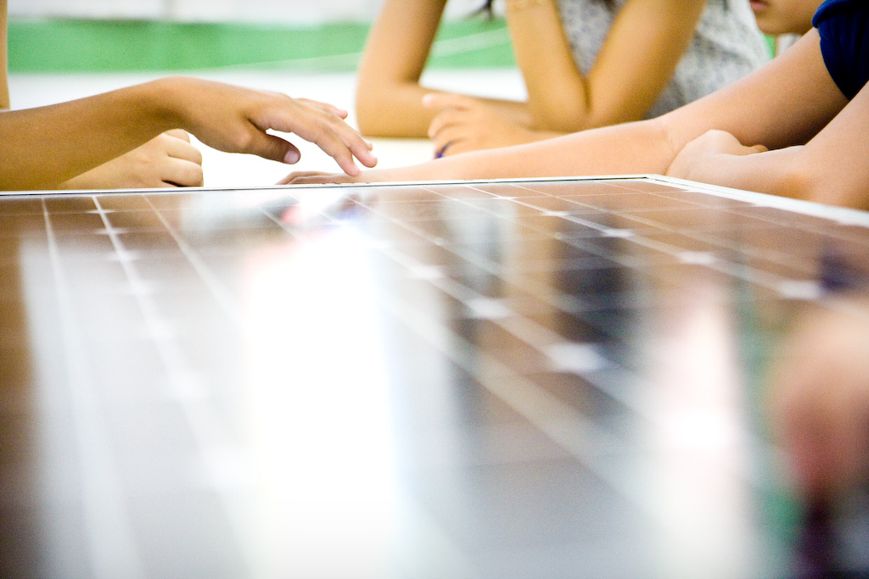
Showcase
Essential conditions
Opportunity to engage – especially community and youth;
Strong communication – awareness;
Social benefits
Be something people could feel connected with or touched by.
Notes:
Among the many tactics available, we’ve decided that a showcase would be a good way to start addressing our message. Also, we’ve established some conditions for it, which are: Engagement; Awareness; Social benefits; People to feel touched or connected with it (in order to help us finance it).

Slide 7
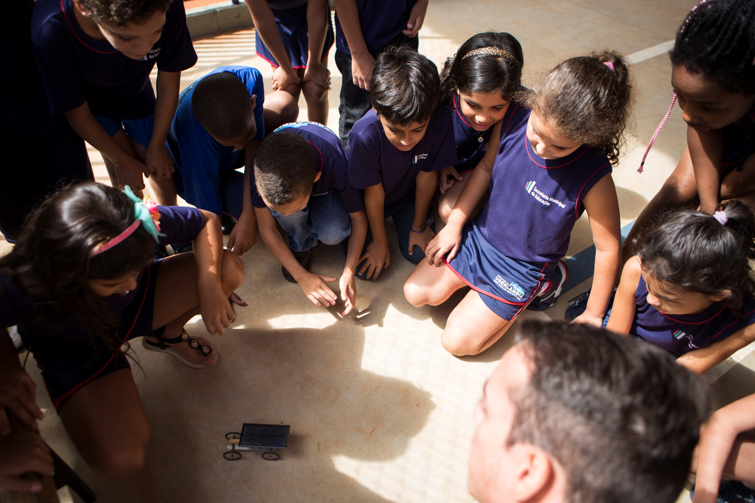

Slide 8
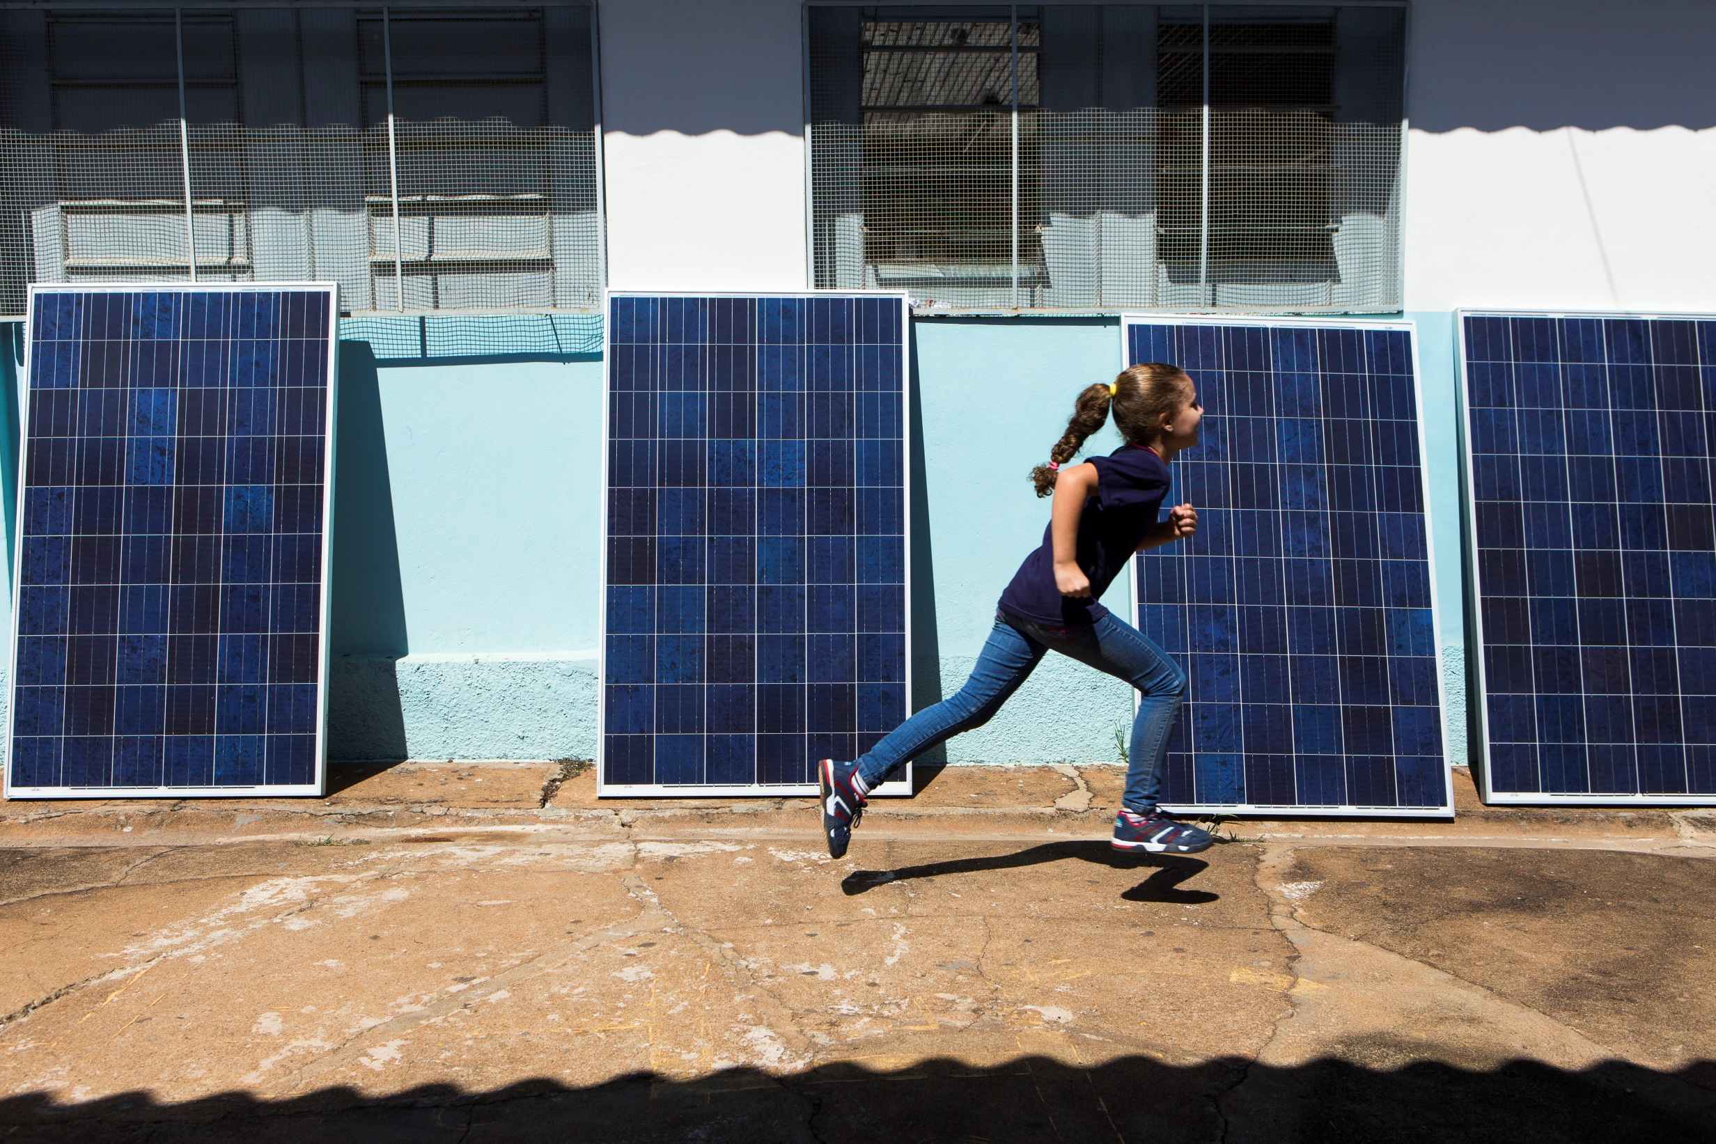

Slide 9
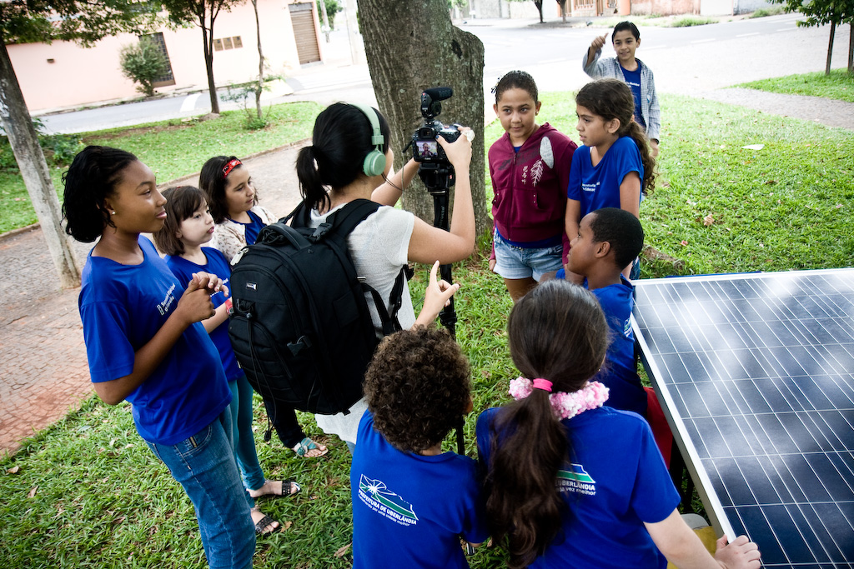
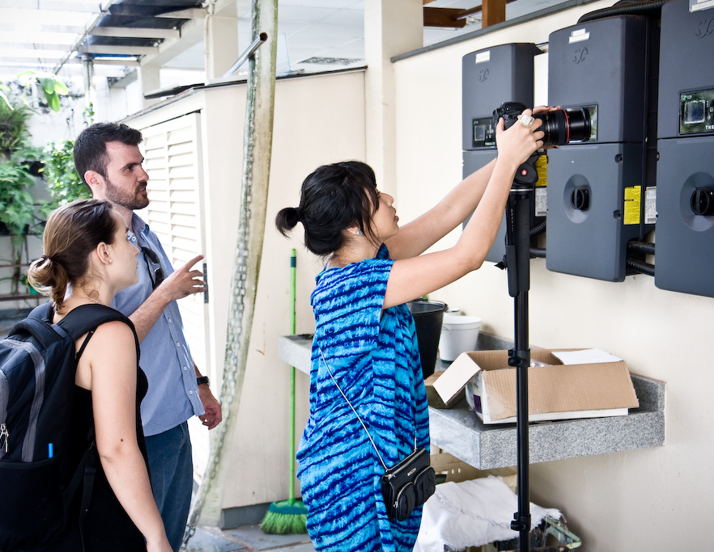

Slide 10
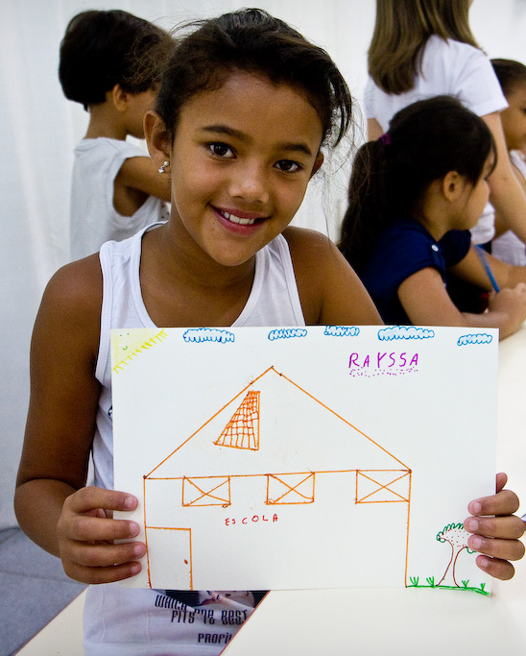
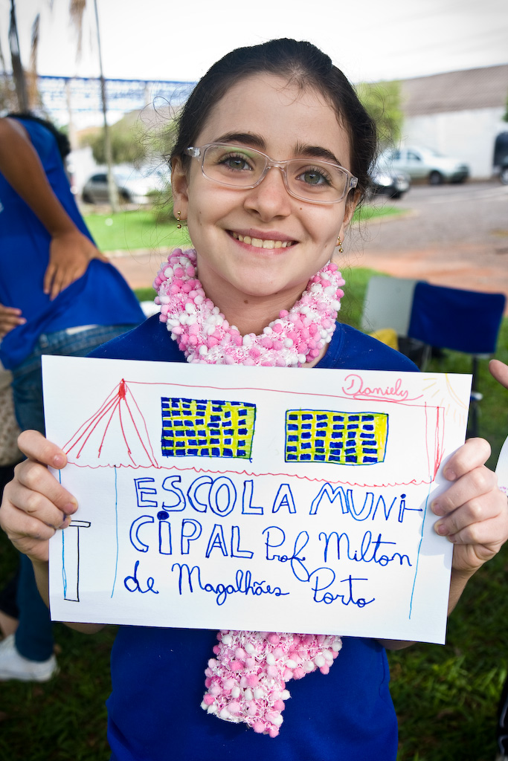

Slide 11
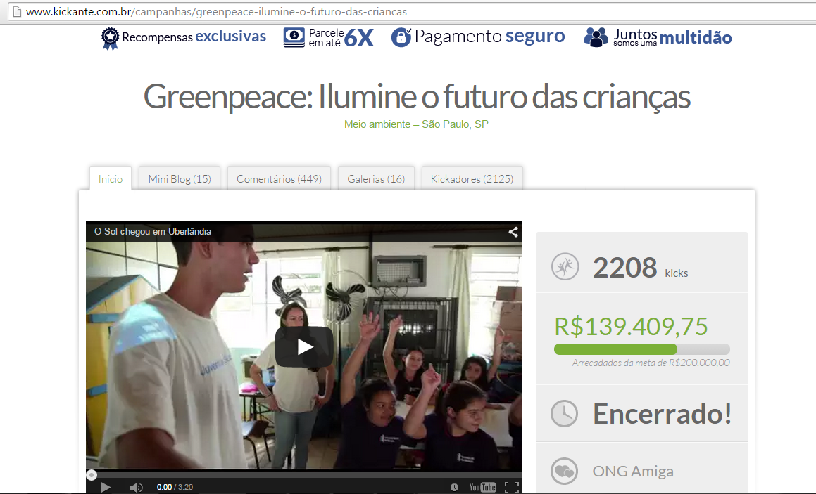
2272 donors
52% were donating for the first time
75% of our goal reached
Notes:
We needed money to turn this into reality, but we also believed it was important that people actually felt like this was their project, so they would feel empowered to replicate it. For that, we’ve launched a crowdfunding campaign.

Slide 12
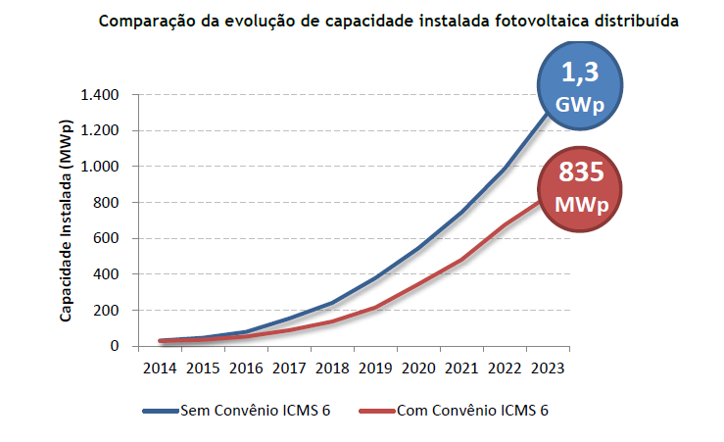
2,0 GWp
1 million solar rooftops

Slide 13
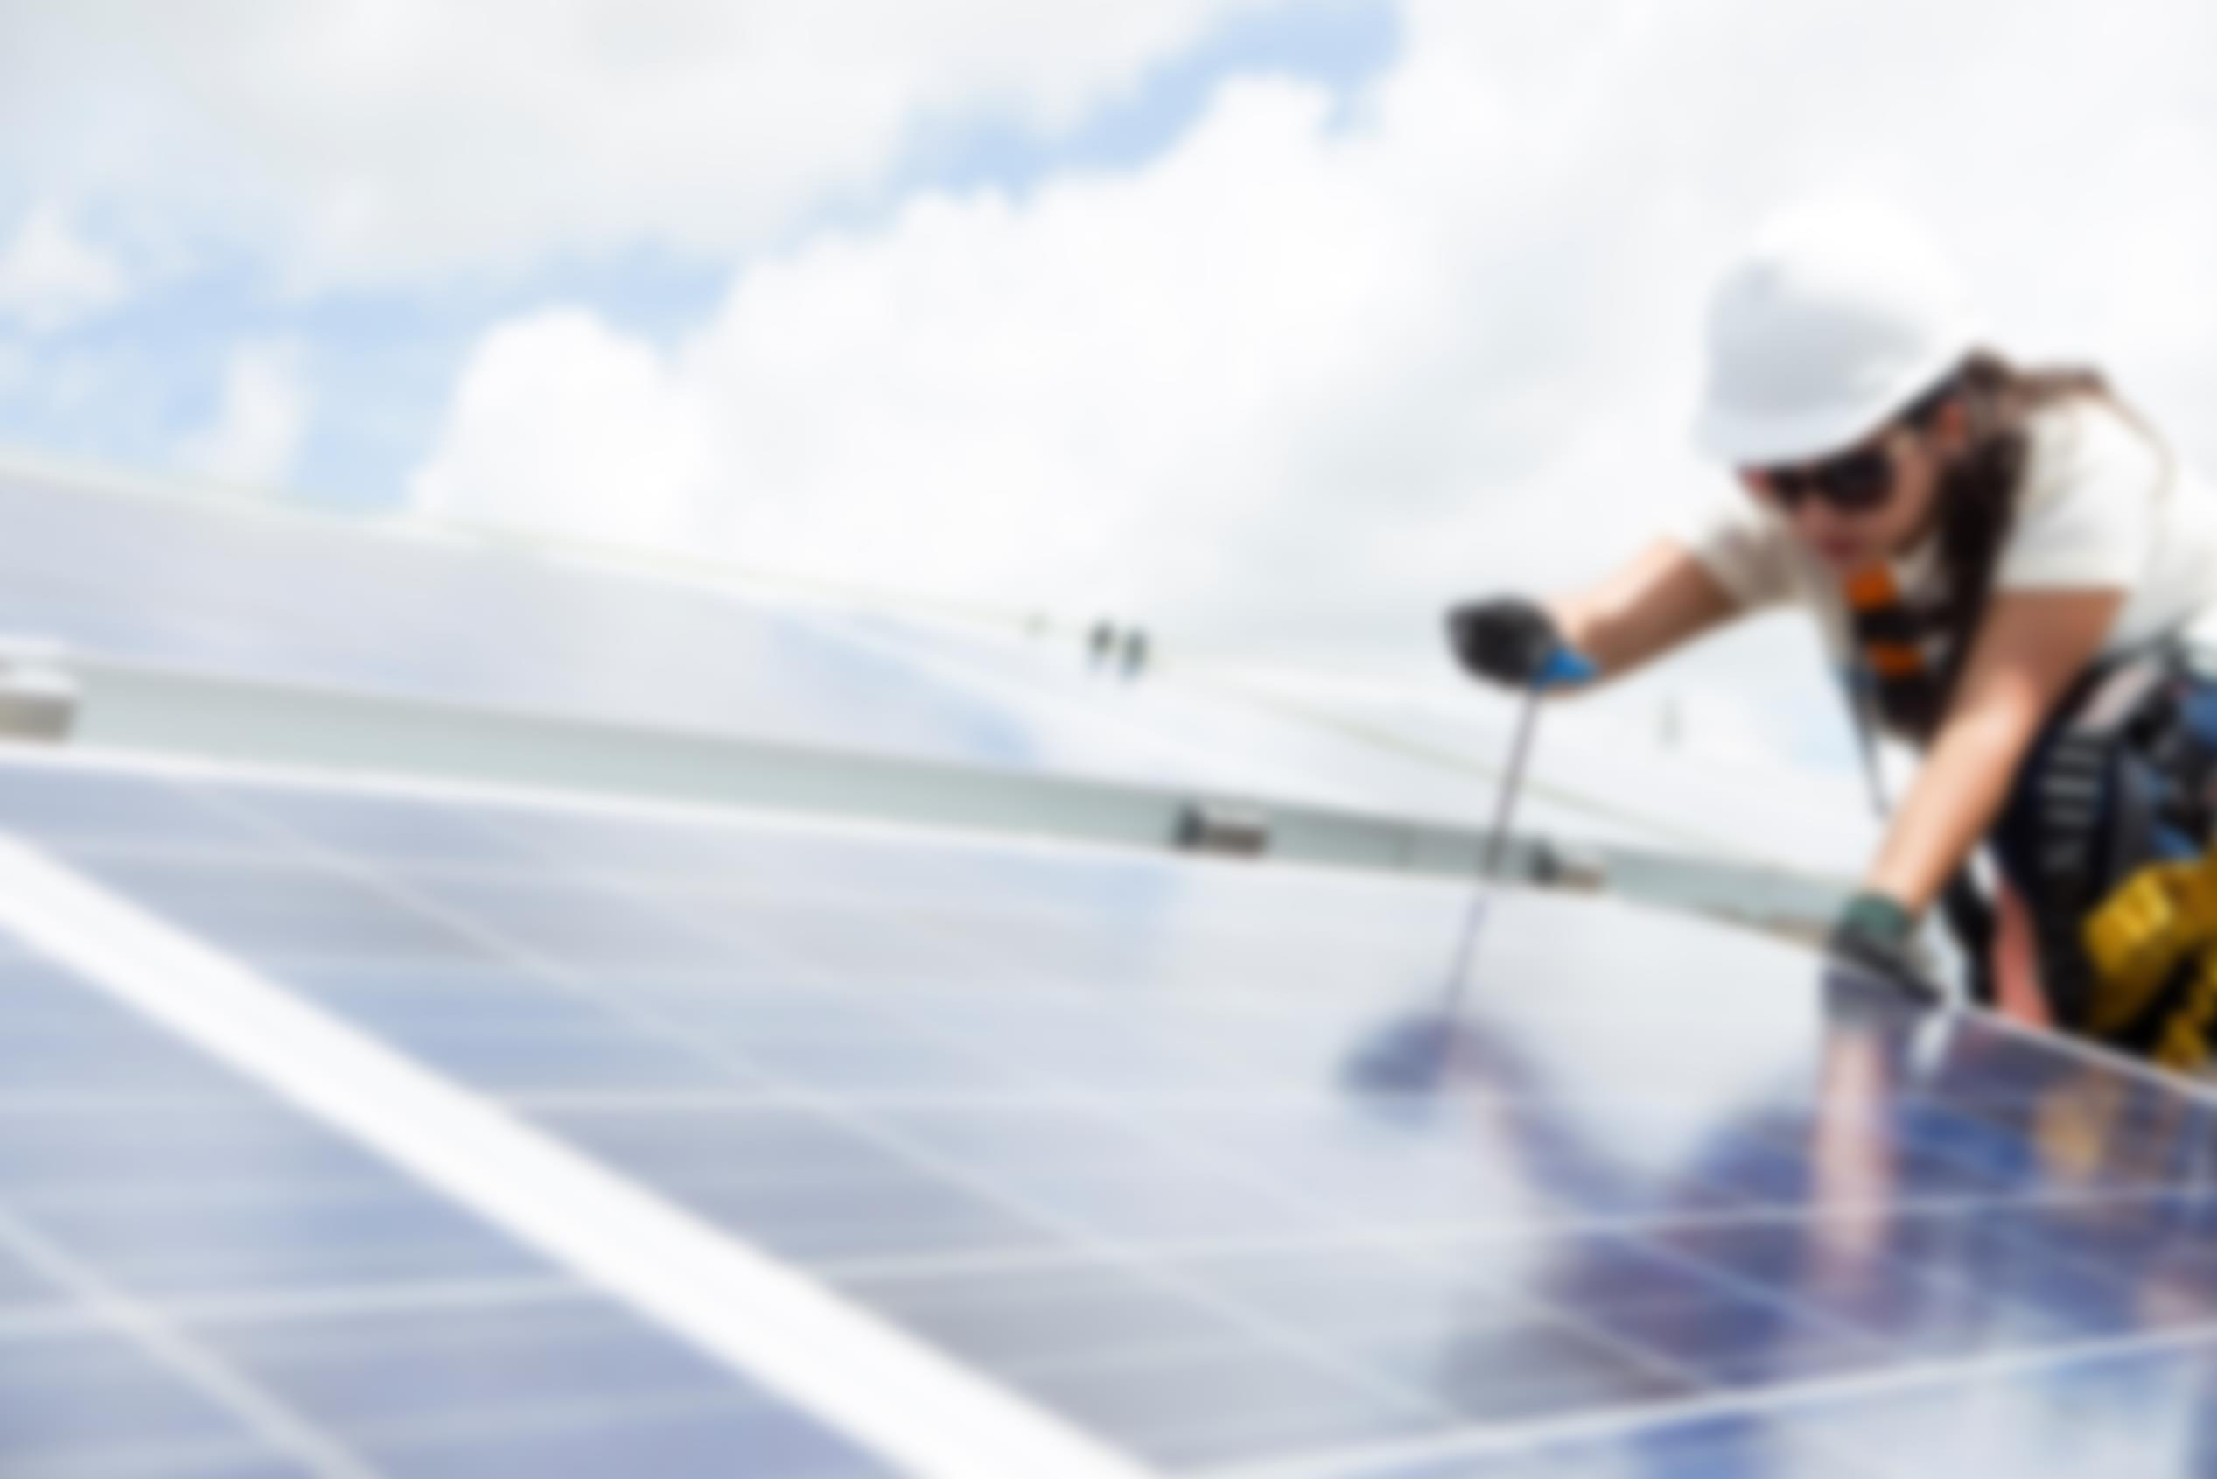
Solar multipliers
What were we looking for?
Group of committed and engaged people willing to help us spread our message.
Notes:
3 months after our project went live, results already go beyond our expectation. We managed to implement the tax exemption we’re seeking for in São Paulo, our message was spread and other communities are asking our solar multipliers help.

Slide 14
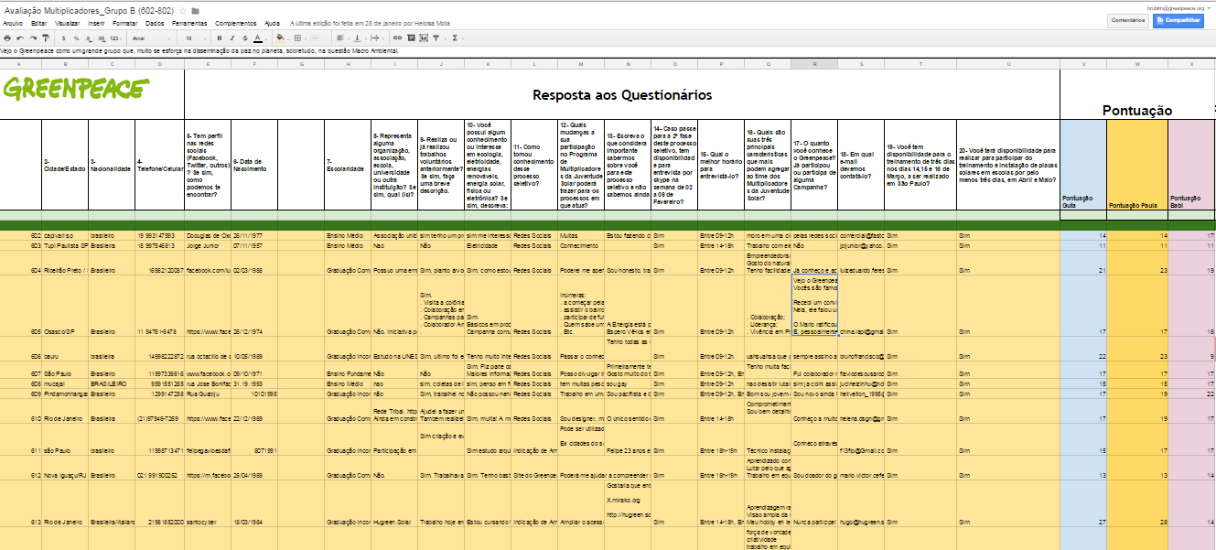

Slide 15
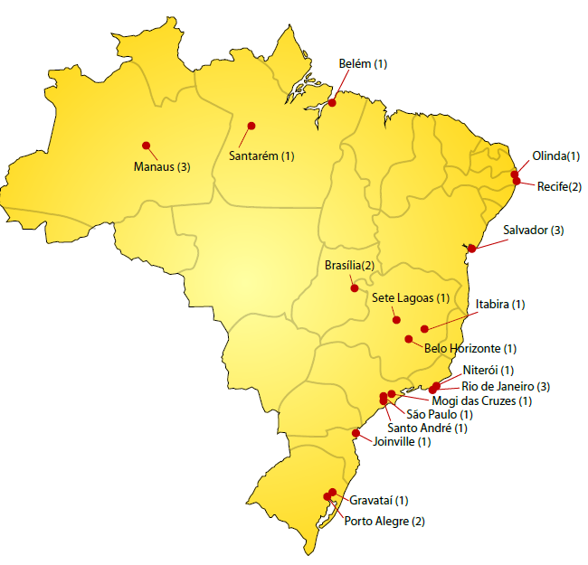
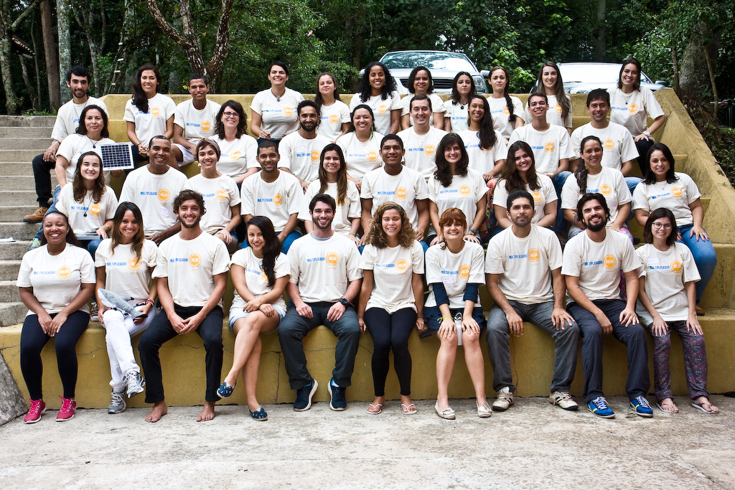
30 Solar Multipliers
Notes:
But this wasn’t enough to create all the engagement we’re seeking. So we’ve decided to select and train a group of 30 people – selected among more than 2000 candidates – that would help us train other people and spread the message that a better future is possible and sometimes it starts at your rooftop.

Slide 16
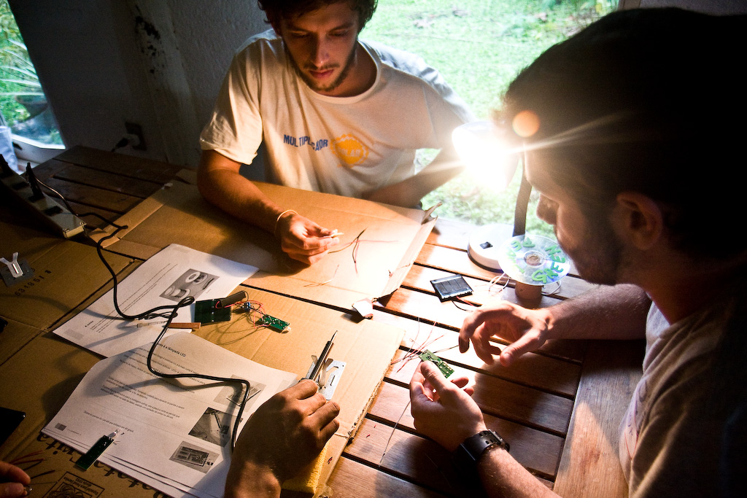
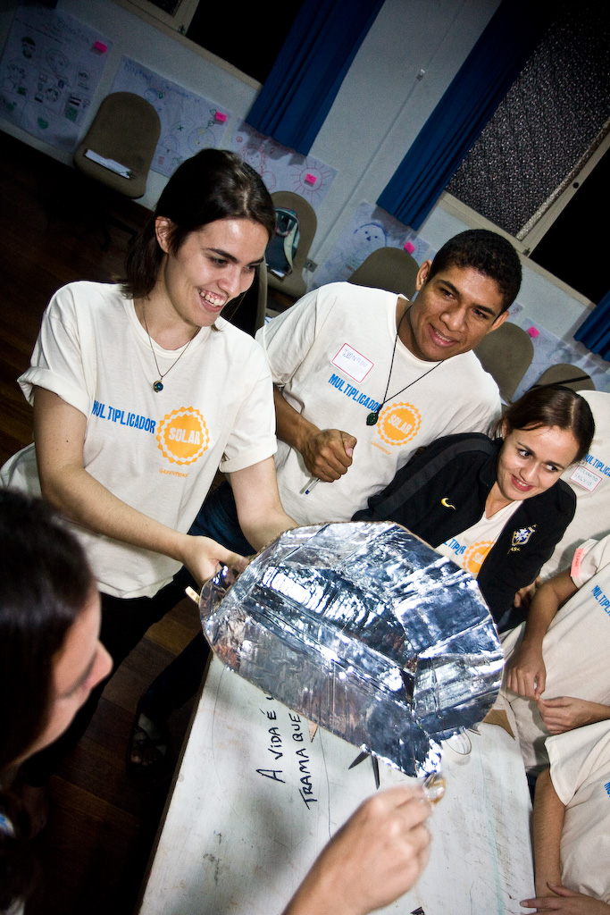
Notes:
To make this amazing group of people ready for their mission we’ve gathered them together for 3 days in which they’re instructed on how to cook with solar energy as well as how to produce electricity with it, install systems, lobby, etc. A pedagogue was there to make sure they also learned the best way to communicate and pass this knowledge

Slide 17
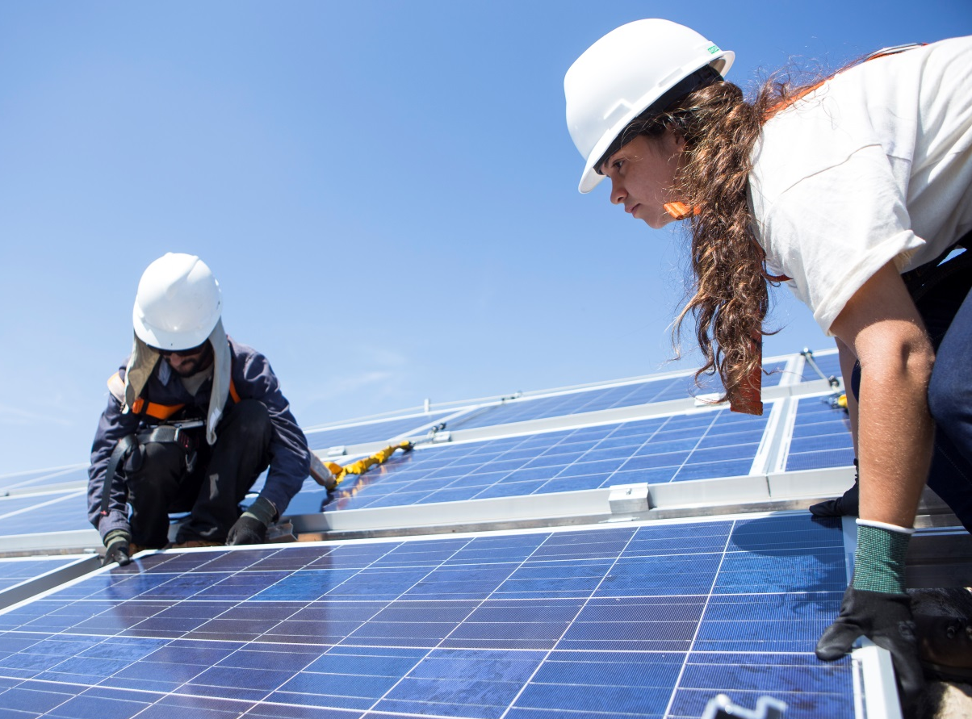
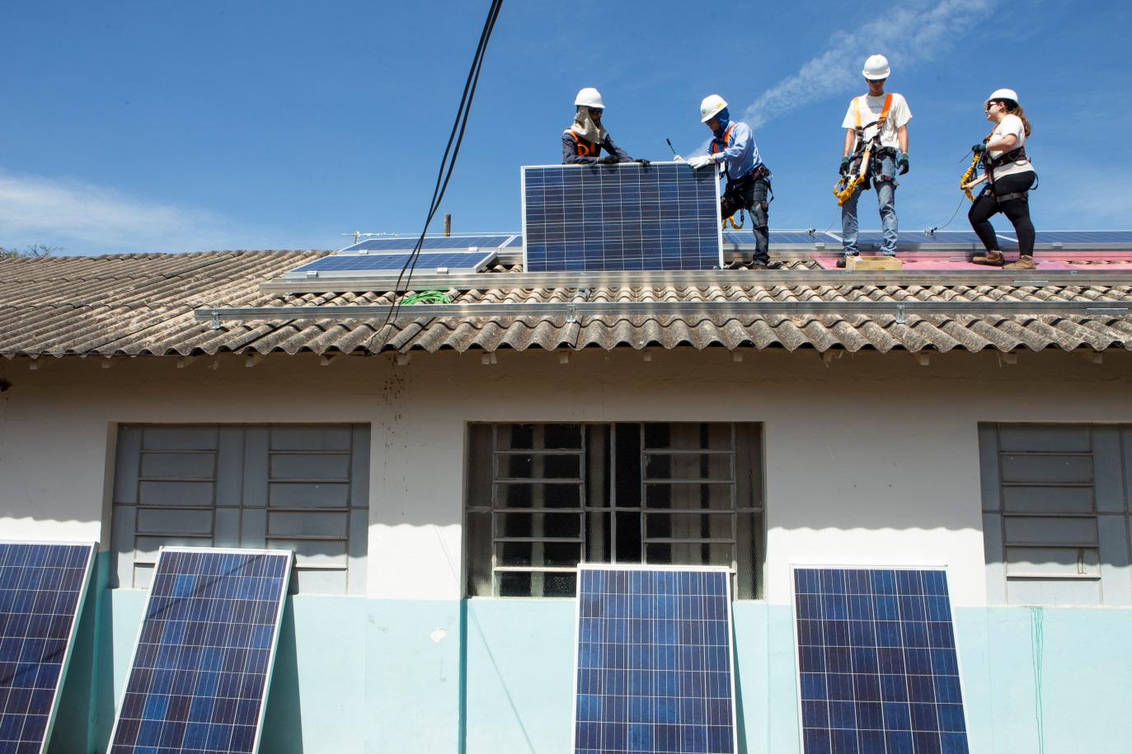
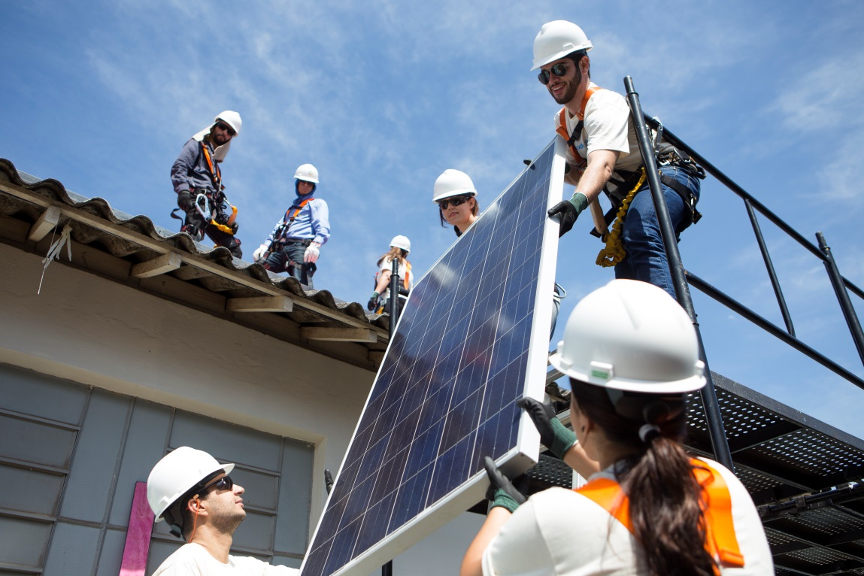
Notes:
A month later they brought this knowledge for the two public schools we’ve previously selected. There, they installed the PV systems and developed lots of activities with the students, teachers and parents.

Slide 18
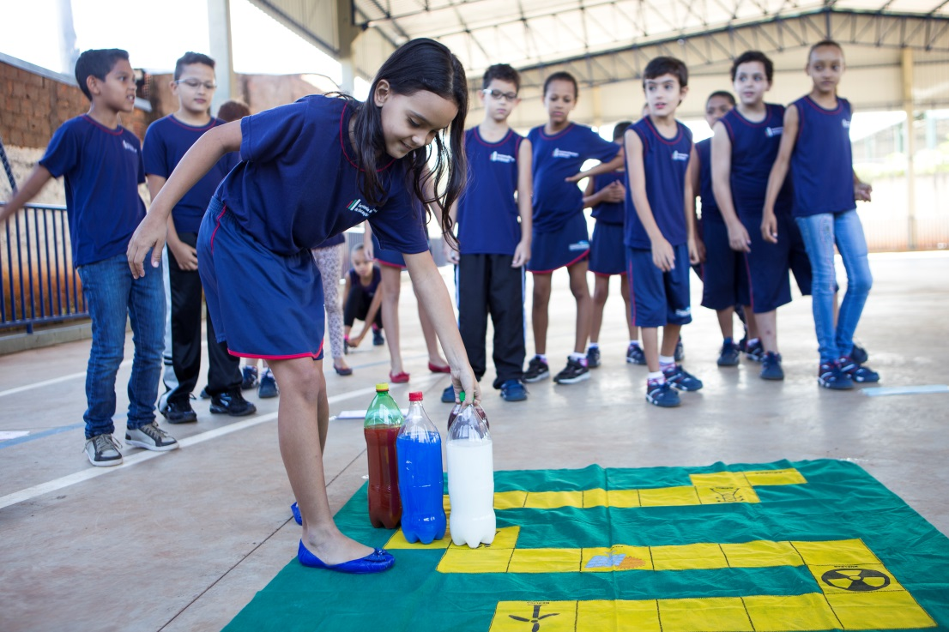
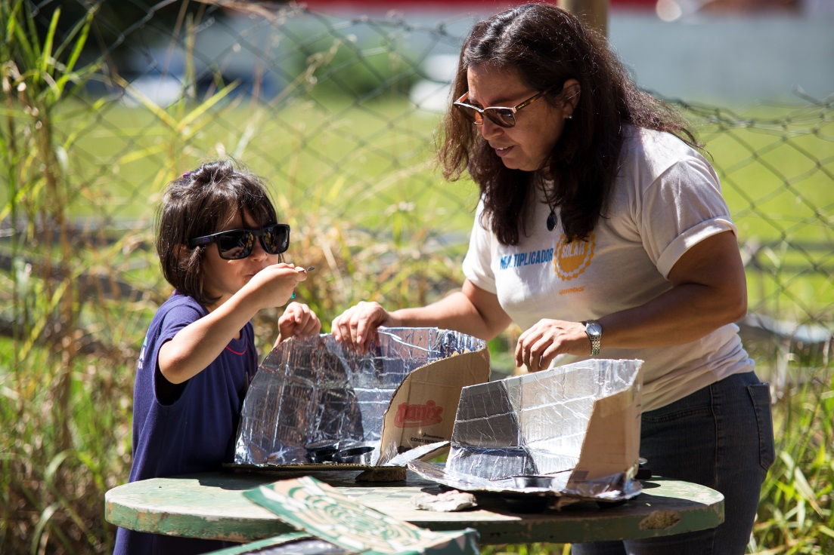
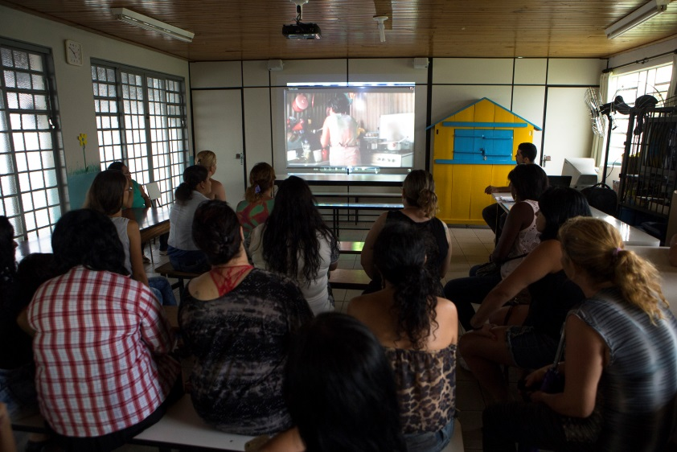
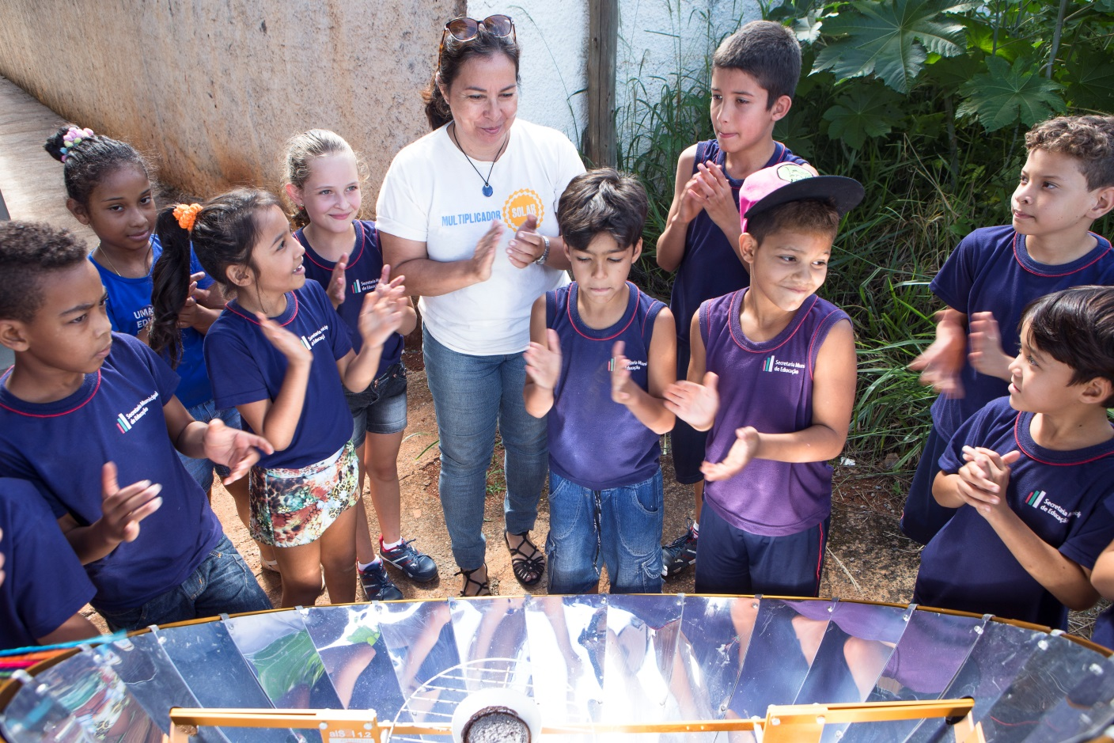
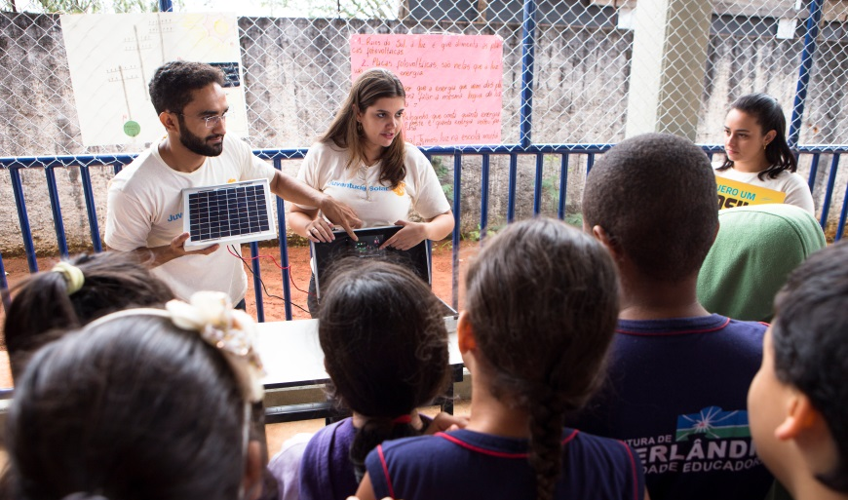
Notes:
We stood 4 days in each school and still the results are amazing. XX students, YY parents and LL teachers are now more aware of the importance of solar energy for them and their community than they were before. But that’s not all. As renewable energy also means jobs, our solar multipliers – as we kindly call them – were not alone.

Slide 19
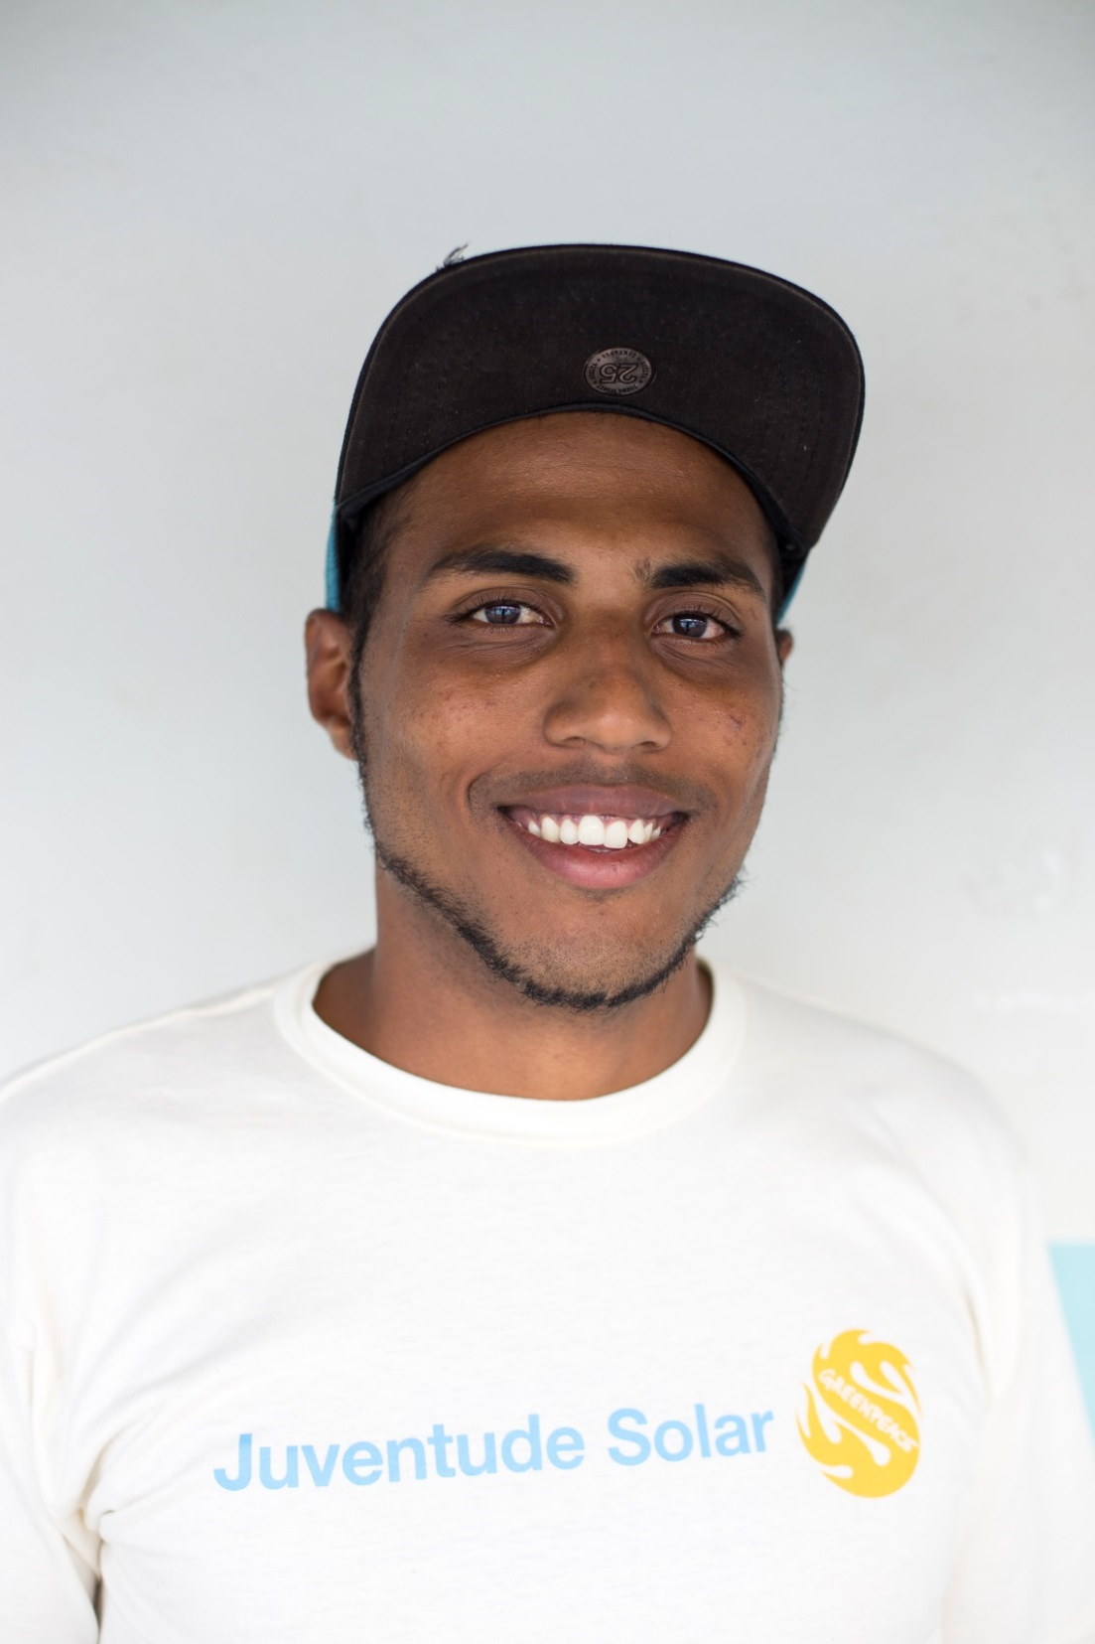
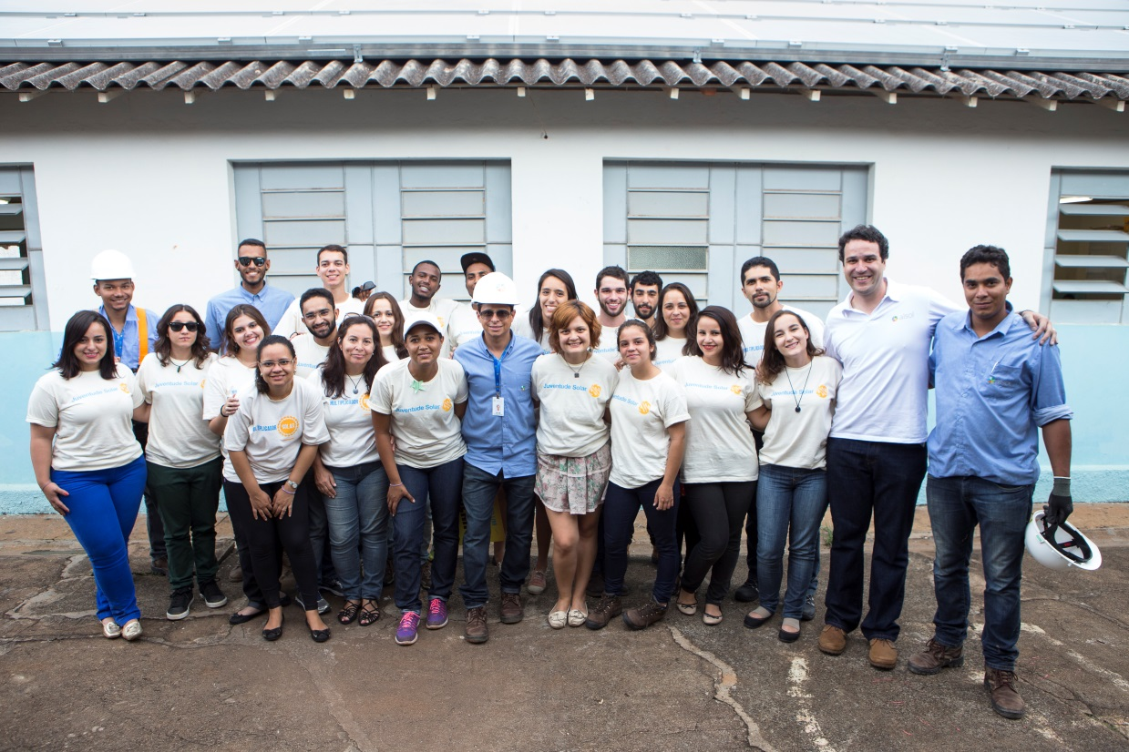
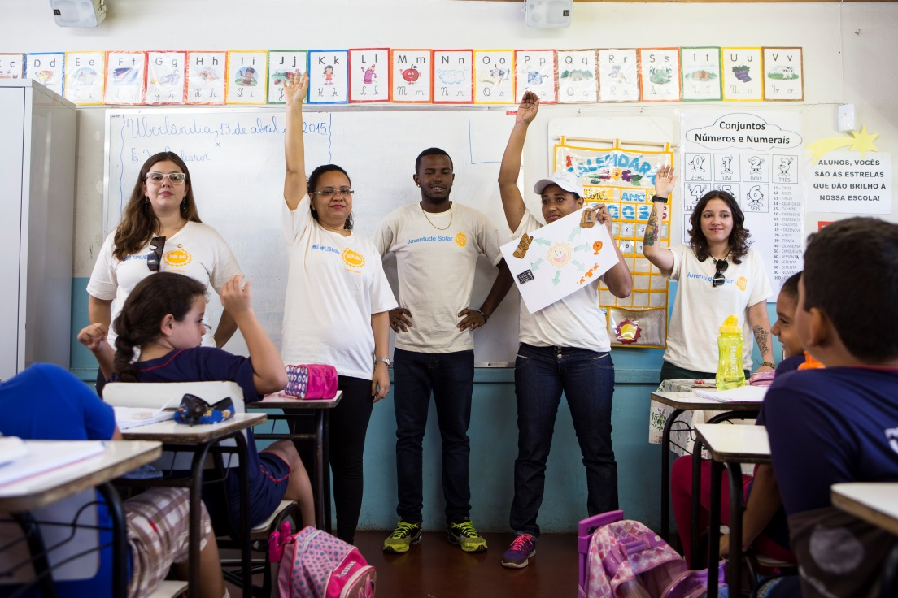
Notes:
In the first school they’ve also trained 4 young that were part of a government program to keep them alive and away from violence and drugs. At the end, one of this young – Jeferson, from the picture -, was hired by the solar company that was helping us.

Slide 20
Tax exemption on the state where the school was solarized
Solar multipliers invited to help in other instalations
15 million people reached on our social network
Notes:
3 months after our project went live, results already go beyond our expectation. We managed to implement the tax exemption we’re seeking for in São Paulo, our message was spread and other communities are asking our solar multipliers help.

Slide 21
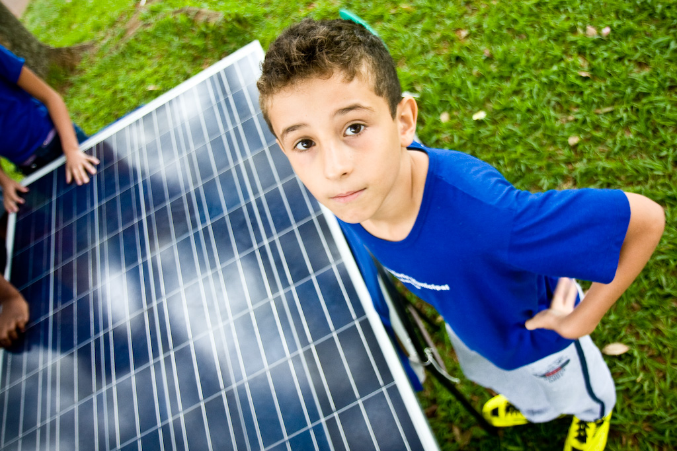
What’s next?
Notes:
The installed systems will provide an economy of US$10,000 every year due to the reduction of electricity bill. But as the system belongs to all the community, we didn’t feel like it was fair for the public power to behold all these savings.

Slide 22
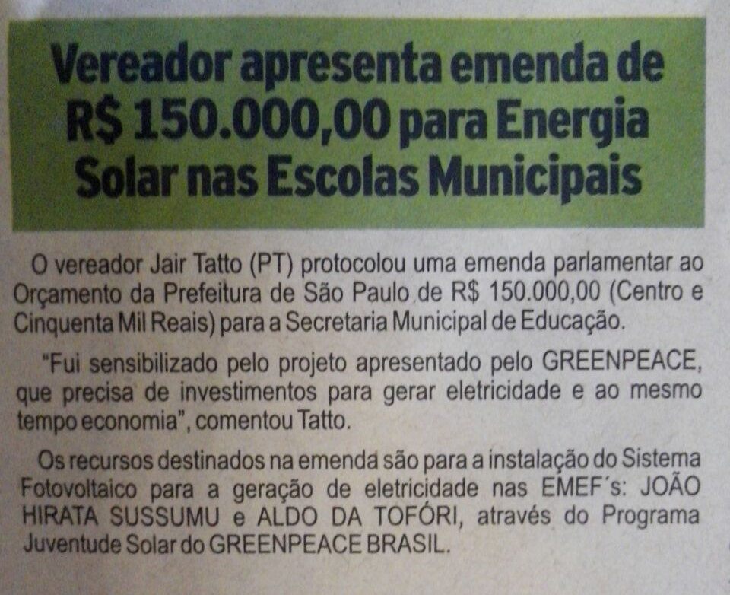
6 Schools waiting to be solarized
National Campaign
Solar Multipliers

Slide 23
Key Learnings
Involve the local community when planning and executing the project;
Agreements with public power take time;
Solar Multipliers were and essential part of the project.
Showcases tend to attract lot of media attention, so use it to communicate your main messages and political asks;
Keep track on the results and follow up.

Slide 24
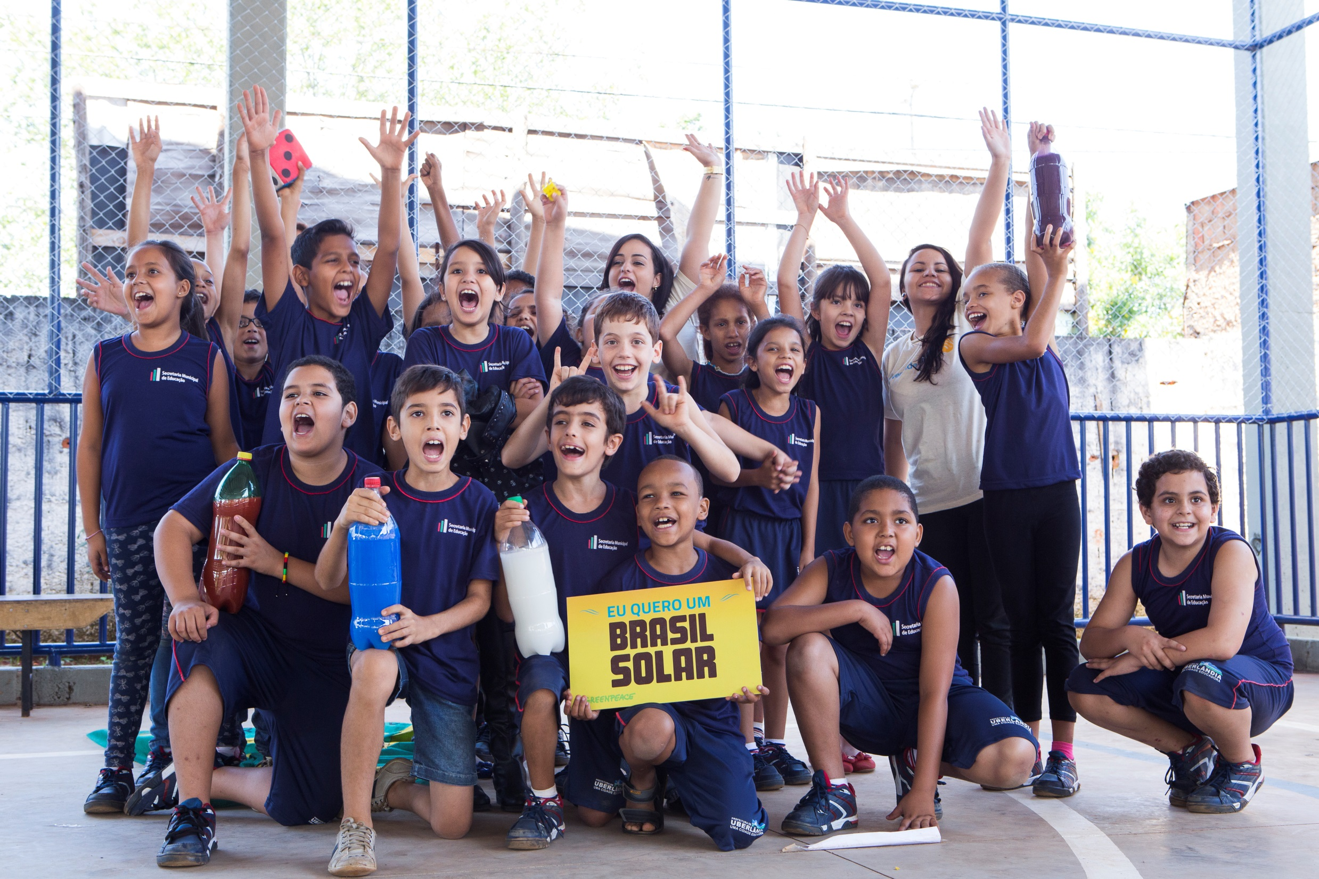

Slide 25
Bárbara Rubim
Renewable Energy Project Leader
Greenpeace Brazil
barbara.rubim@greenpeace.org
Twitter: @bfvrubim

