Slide 1
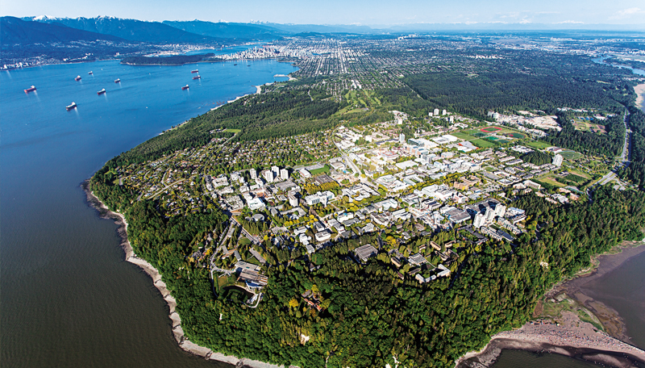
Steam to Hot Water Conversion
The University of British Columbia
Paul Holt Director, Generation & Distribution

Slide 2
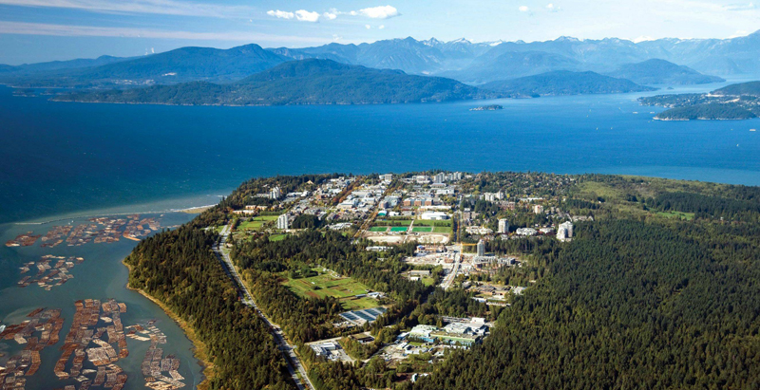
The University of British Columbia
UBC Stats
12 million sq.ft. of institutional buildings
3 million sq.ft. residential
Day time pop. ~ 65,000
~ 30% growth over the next 15 to 20 year
UBC Stats
Steam
785,000,000lbs/year
1.1 million GJ/year NG
78% of GHG emissions
Electrical
309 GWh/year
49 MWe peak load
8% of GHG emissions

Slide 3
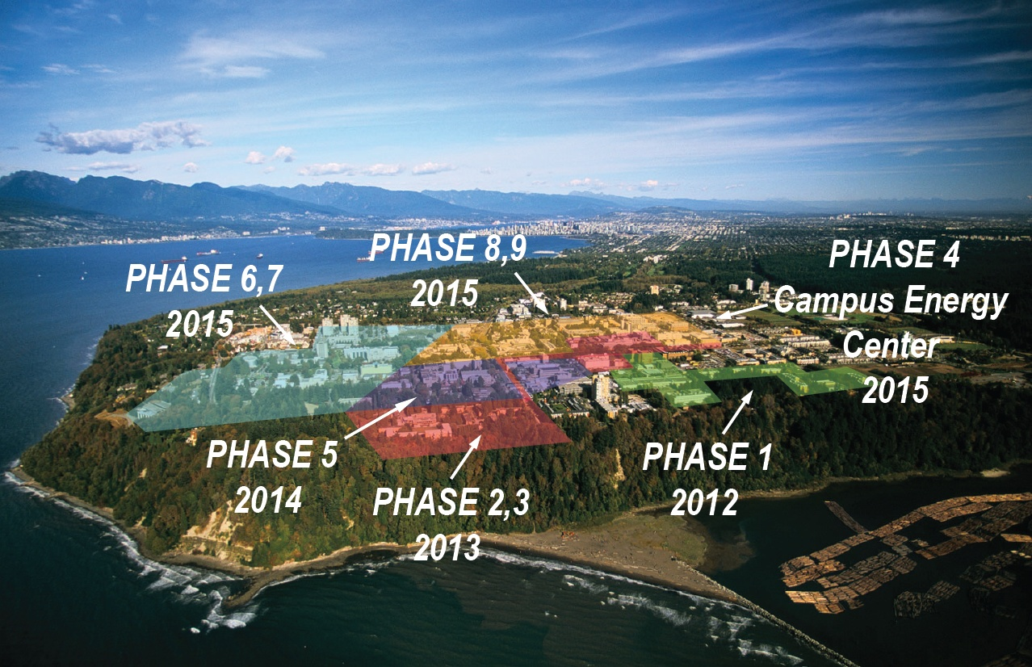
Overview: Steam to Hot Water Project
5 year, 9 phase, $88 million project to convert the campus from steam to Hot Water
11 kilometers of pre-insulated direct buried piping 115 building conversions 60 MW Natural Gas fired Campus Energy Center 9 Orphan Steam Buildings 12 buildings w/ steam process loads requirements

Slide 4
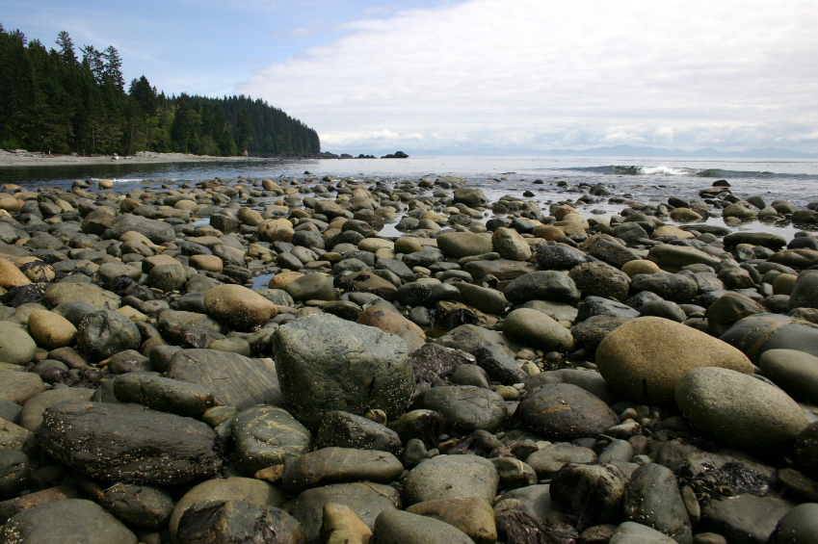
2010 UBC GHG Reduction Targets
UBC adopted its Climate Action Plan in 2010, committing the
university to aggressive greenhouse gas (GHG) reduction targets of:
33% below 2007 levels by 2015
67% below 2007 levels by 2020
100% below 2007 levels by 2050

Slide 5
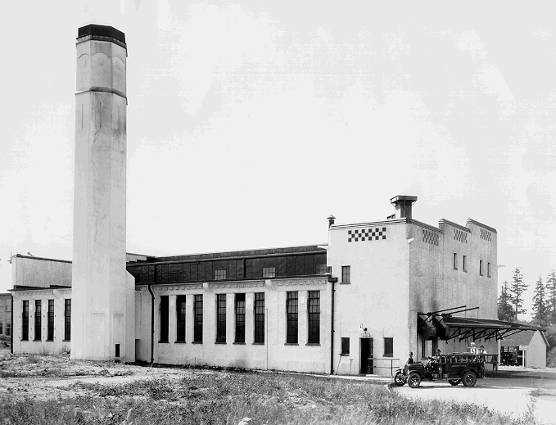
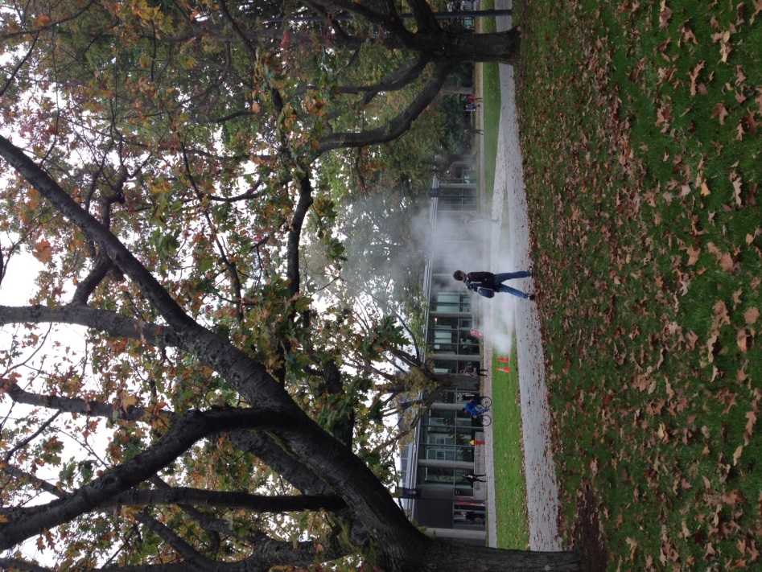
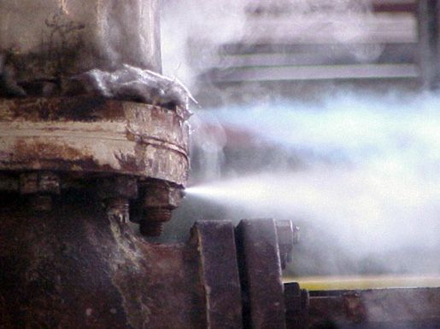
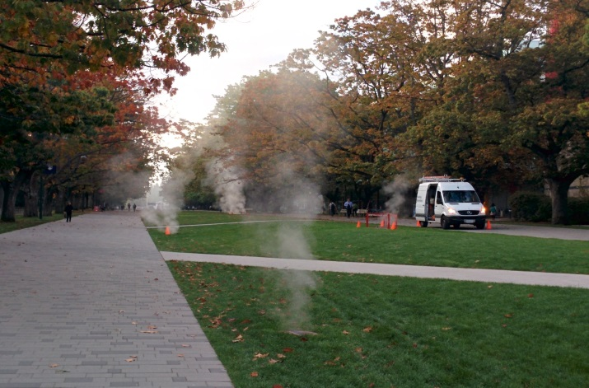
Rationale for STHW
Aging infrastructure – boilers, piping, heat exchangers and plant
Saves $5.6 million per annum in regulatory, commodity, carbon, capital, operational & maintenance costs
Reduces Campus Greenhouse Gas emissions by 22%
Increased energy supply options
Risk mitigation strategy
6th October 2014
8th October 2014
Notes:
Average 30 year operating costs excluding loans estimated at 15.4 Million for hot water Vs. 21 Million for steam = 26% savings

Slide 6
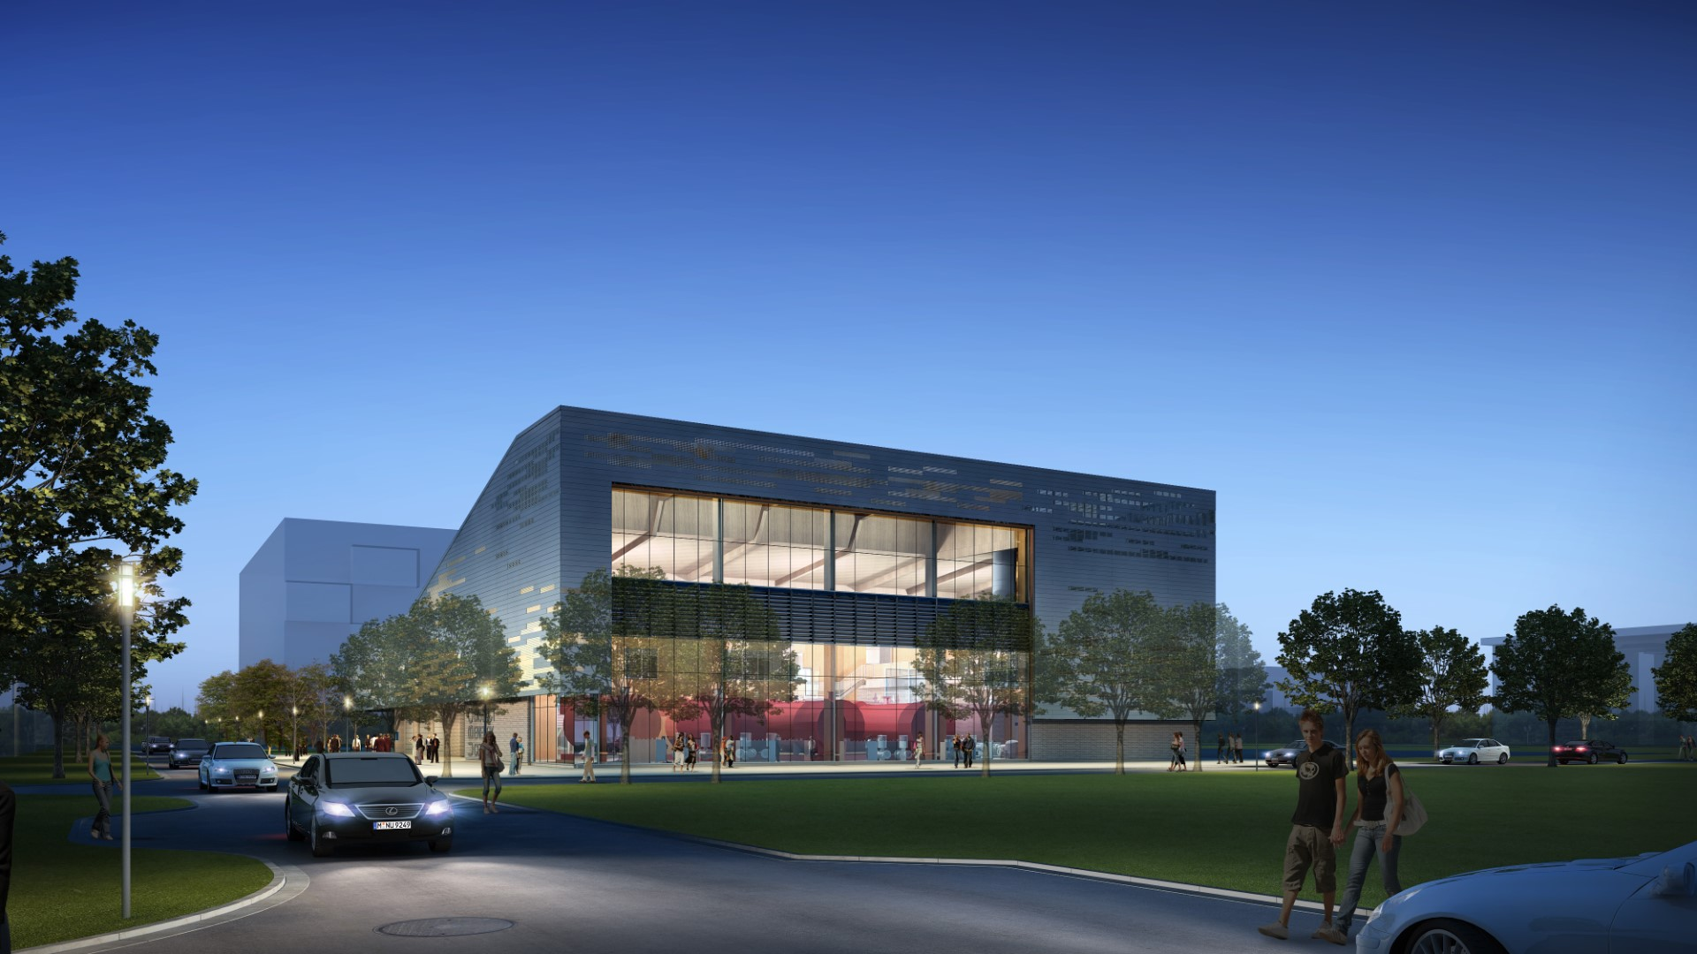
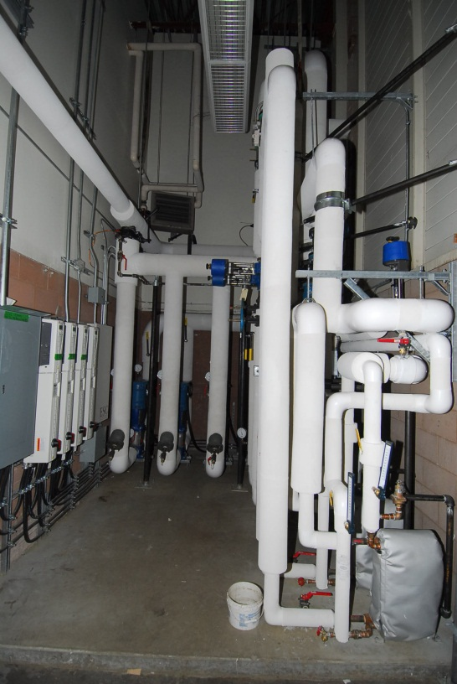
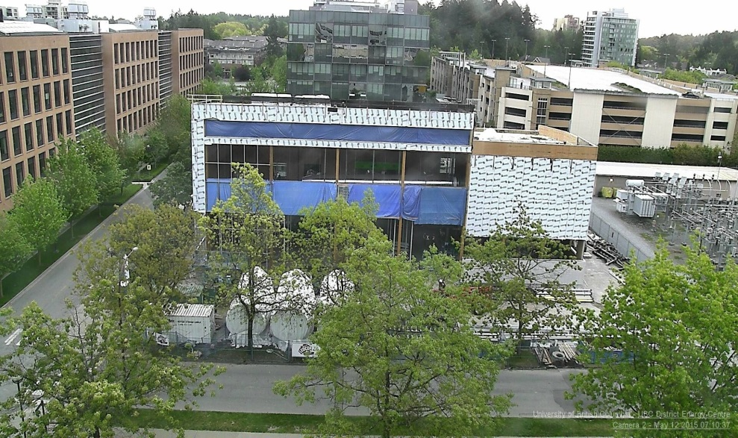
Campus Energy Centre
Expected Boiler Commissioning September/October 2015
Initial build: 3x15MW (3 x 1,500BHP) Natural gas/#2 diesel boilers
1 MW condensing economizer
Designed for future expansion i.e. Built for 4 boilers with 3 installed. Site chosen to allow for further building expansion and integration with clean energy technologies e.g. Cogeneration
12th May, 2015

Slide 7
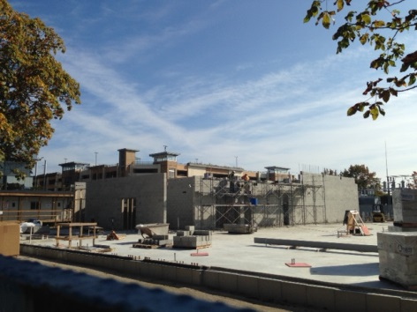
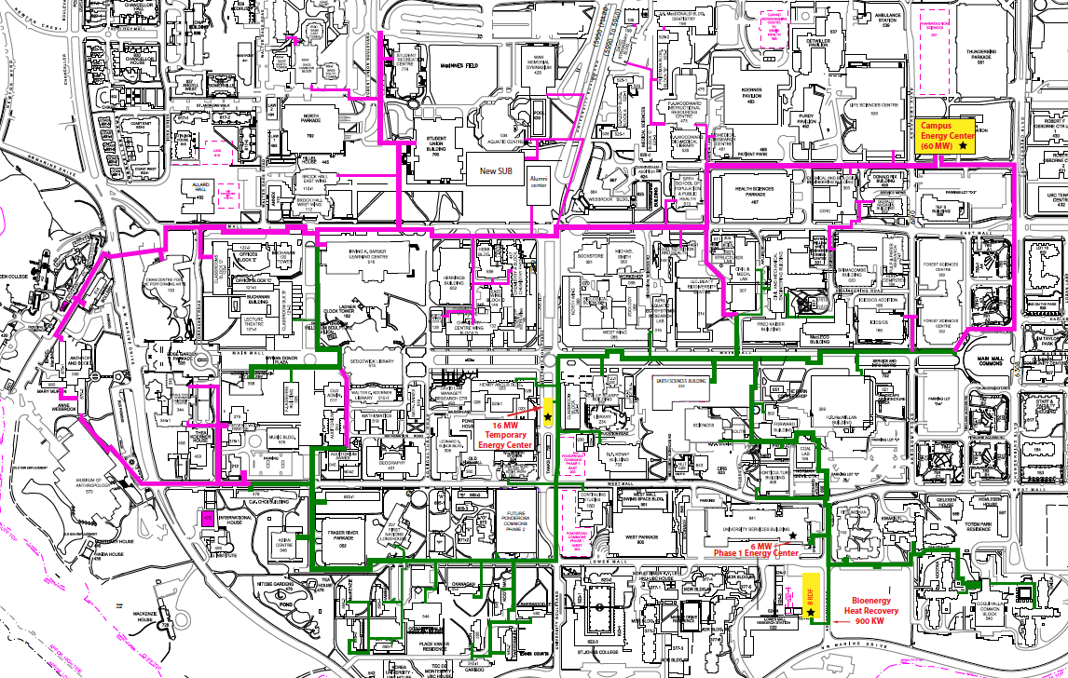
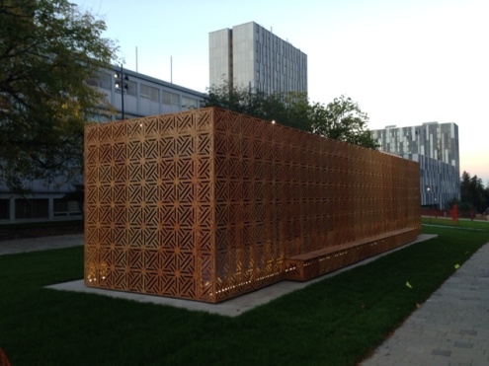
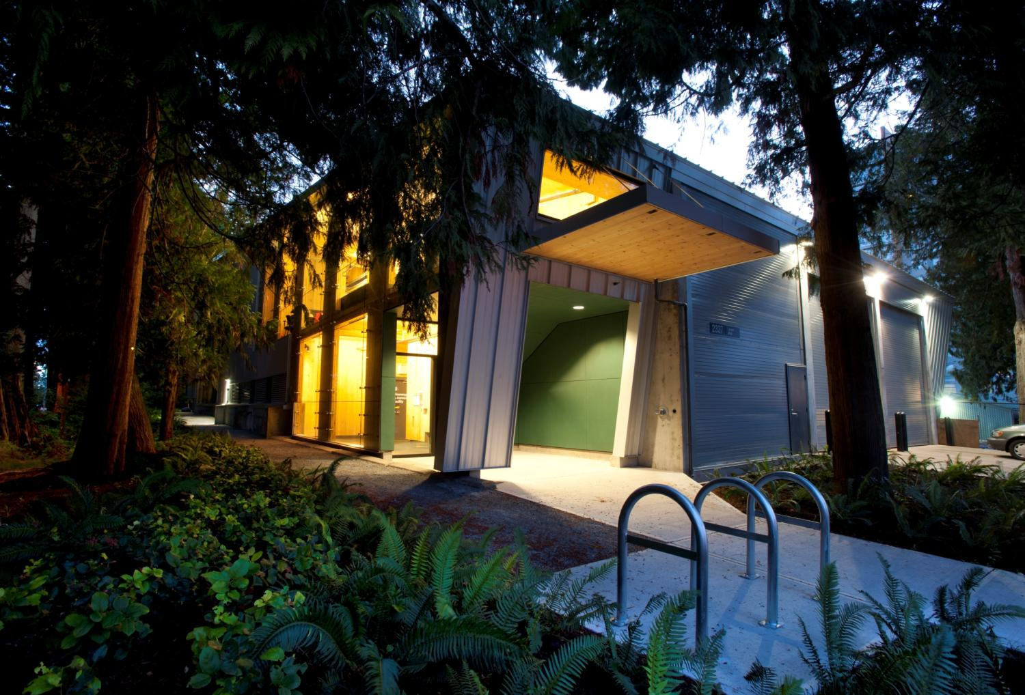
Energy Centre’s
60 MW Hot water
Campus Energy centre
(Under construction)
16 MW Temporary
Steam to hot water
Station complete
(In service)
6MW Biomass
2 MW Cogen (HR)
(In service)

Slide 8
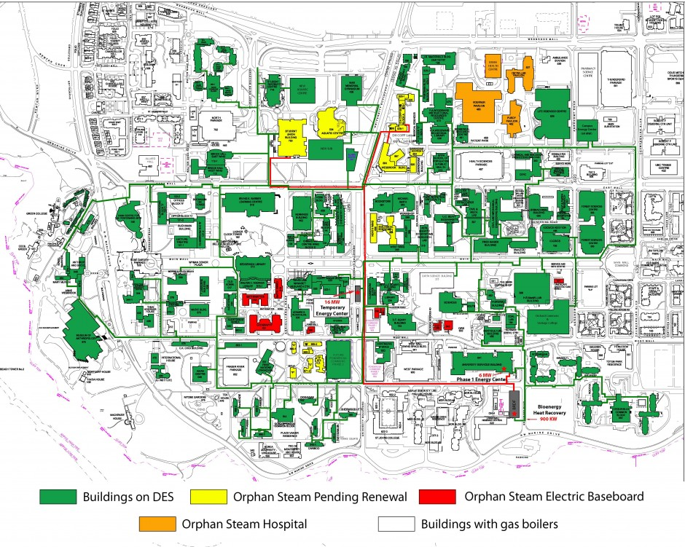
Expected Nov/Dec 2015 All Planned UBC Buildings Converted

Slide 9
Conversion Challenges
Design (High Temp steam)
Orphan Buildings and Process Loads
Cost control/escalation
Retrofit existing buildings
Interruptions to end users

Slide 10
Approach
Value Engineering
  Tackles cost, benefit from existing infrastructure
  Combine buildings on secondary side - meter
  Historical data / HEX selection
  Top up equipment (eg. Dish washer)
  Aligning with other ongoing projects (Public Realm)
  Maximizing above ground (steam tunnel / existing buildings)

Slide 11
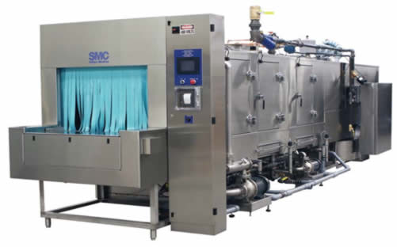
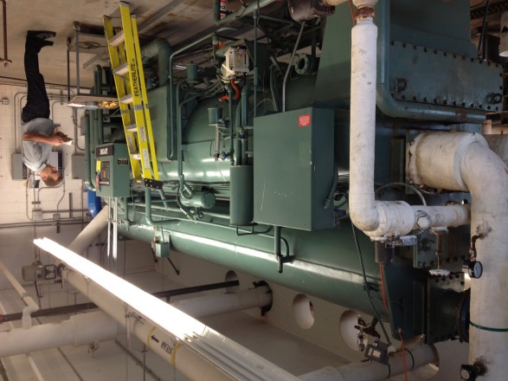
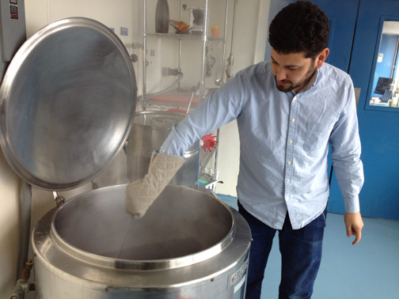
Approach
Orphan steam
  Tackles design constraints non hydronic buildings & process requirements
  Cost – micro steam grids
Process
    Sterilization (Autoclaves, cage washers)
    Humidification – Generally not required in Vancouver
      6 Buildings found to required steam for humidification
      Museums, Rare books, animal care
    Absorption chillers
    Kitchens – Dishwashers and steam kettles

Slide 12
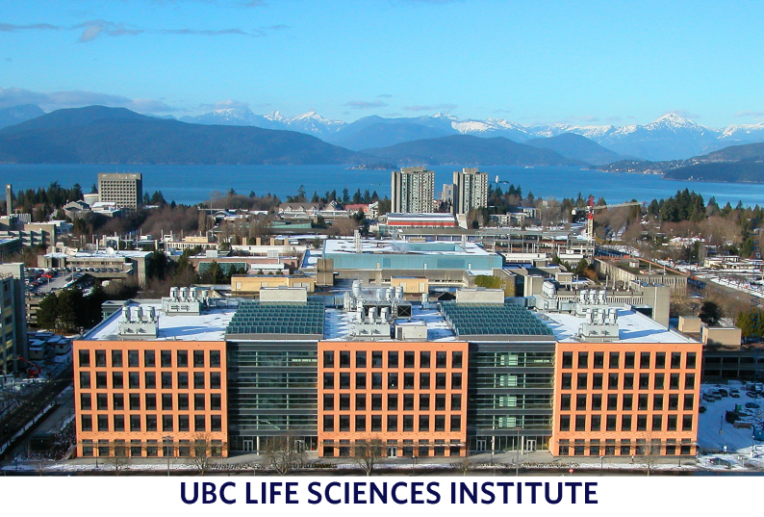

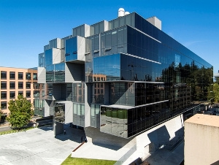
LSC and Pharmacy Process Steam Microgrid, Proposed
HP Steam Header
LP Header
Building ~6MWt/hr
Process peak 4,000lb/hr
ADES

Slide 13
Approach
BIM
  Tackles retrofit constraints
  Laser scanning facilitates design
  3D modeling facilitates construction and reduces interruptions (Vanier example)
Project Management
  Coordinate disruptions and manage end user expectations
  Facilitate special requests (exams / campus events)

Slide 14
Conclusions to Date
Project is currently 90% tendered, on schedule and on budget
Phased implementation:
  allowed for lessons learned in earlier phases to be incorporated into future phases
  Use of Existing steam HEX’s and a TEC, allows for the early energization of DPS & building conversions, before the new Campus Energy Center is commissioned
  verified costs estimates
  delivered energy and cost savings from phase 1 onwards
Utilize Existing infrastructure
Assess individual buildings to maximize benefit with available budget
Elimination of 80+% of existing boiler pressure vessels (BPV) and steam regulated equipment within converted buildings.
STHW on target to achieve a minimum 22% GHG reduction as expected by end 2015

Slide 15
Paul Holt paul.holt@ubc.ca
15

